Slide 1
How to build a high-performing content team
Mike Spenceley
Director, Global Content Strategy
January 2023

Slide 2
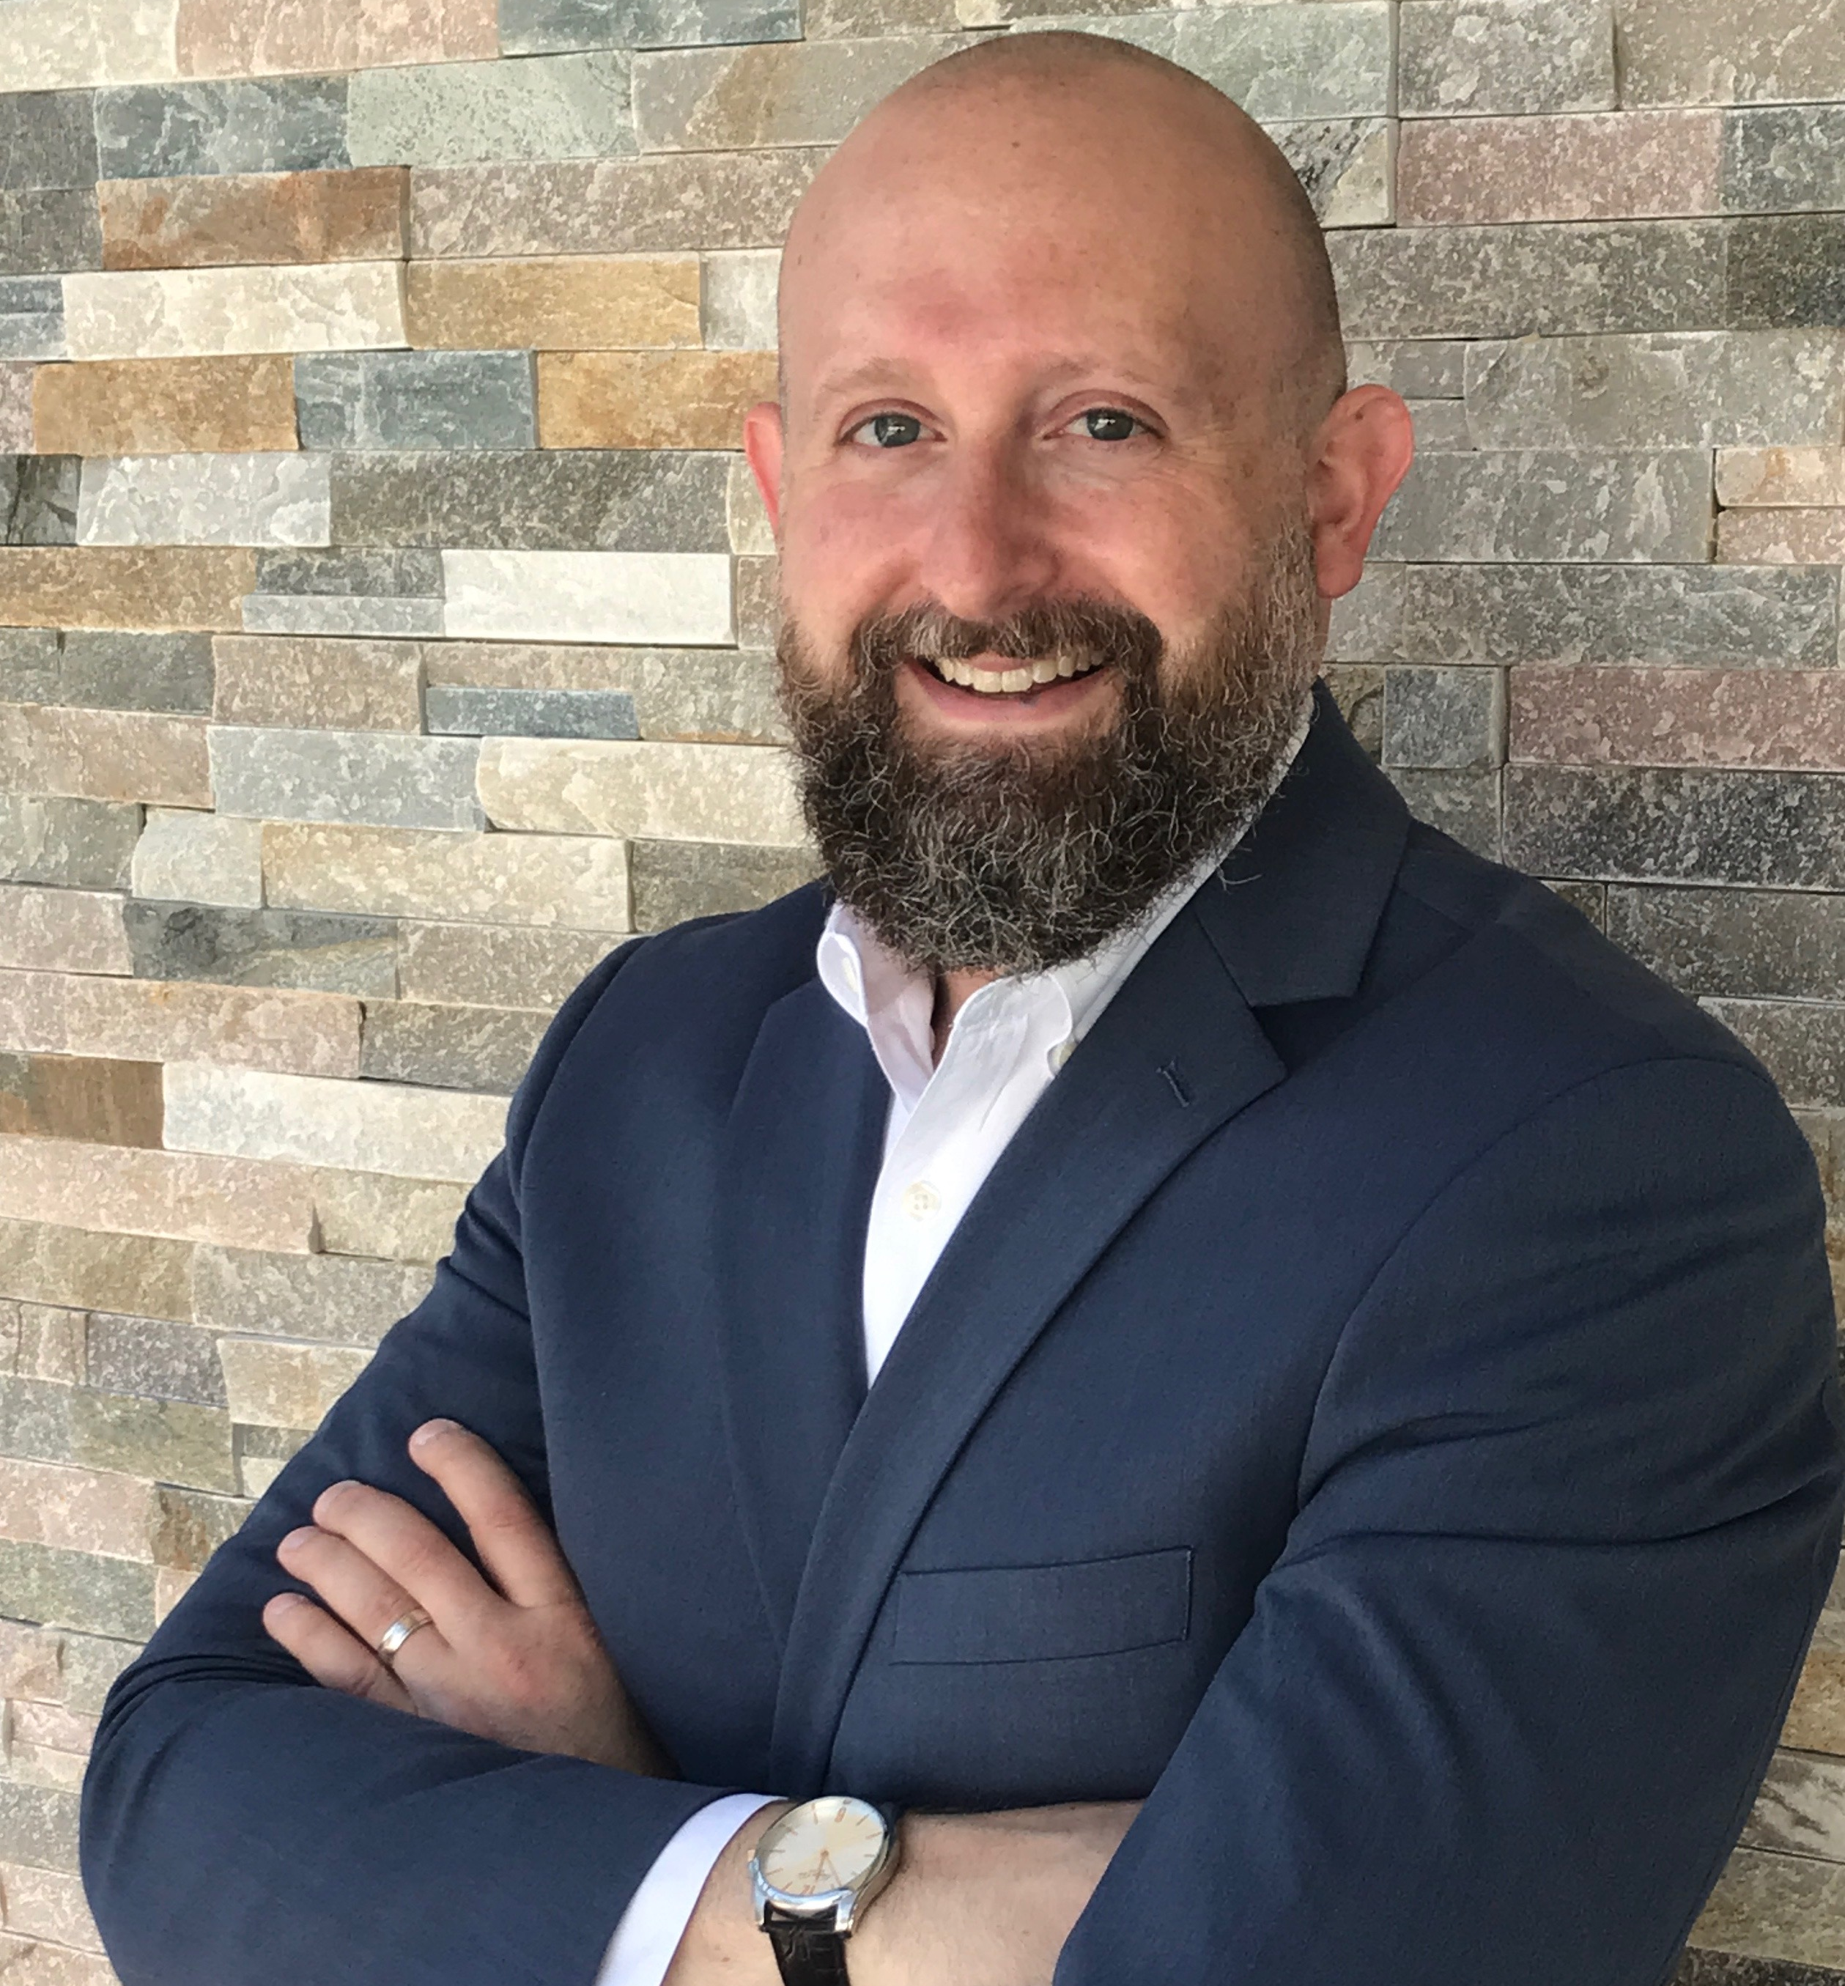
Mike Spenceley
Johnson & Johnson, Global Services
6 years at J&J
4 years as Director, Global Content Strategy
2 years as Global Knowledge Management Lead
Prior to J&J, 10 years at PwC

Slide 3
Global Services Scope
In addition to our in-scope services below, GS also invests resources to support enterprise transformational projects
Finance
Procurement
As the “central nervous system” of J&J, Global Services delivers advanced solutions, game-changing innovation, and improved user experiences to all Johnson & Johnson businesses, sectors and regions.
Account to Report
Invoice to Cash
Payroll / Time and Attendance
Expense Reporting & Reimbursement
Master Data Management
BPO Partner Governance
Source To Pay
Spend Analytics & Reporting
Human Resources
Multi-functional
Talent Acquisition
Learning
People Experience Operations
Total Rewards
Employee Relations Management
Business Continuity
BPO Supplier Management
Contact Center
Enterprise Transformation Services
Common Services Foundation
Change management & comms
Business engagement
Value marketing
Service experience
Portfolio & process management
Service improvement
Global site operations
GS data strategy & governance
Reporting & business insights
Acquisitions & Divestitures

Slide 4
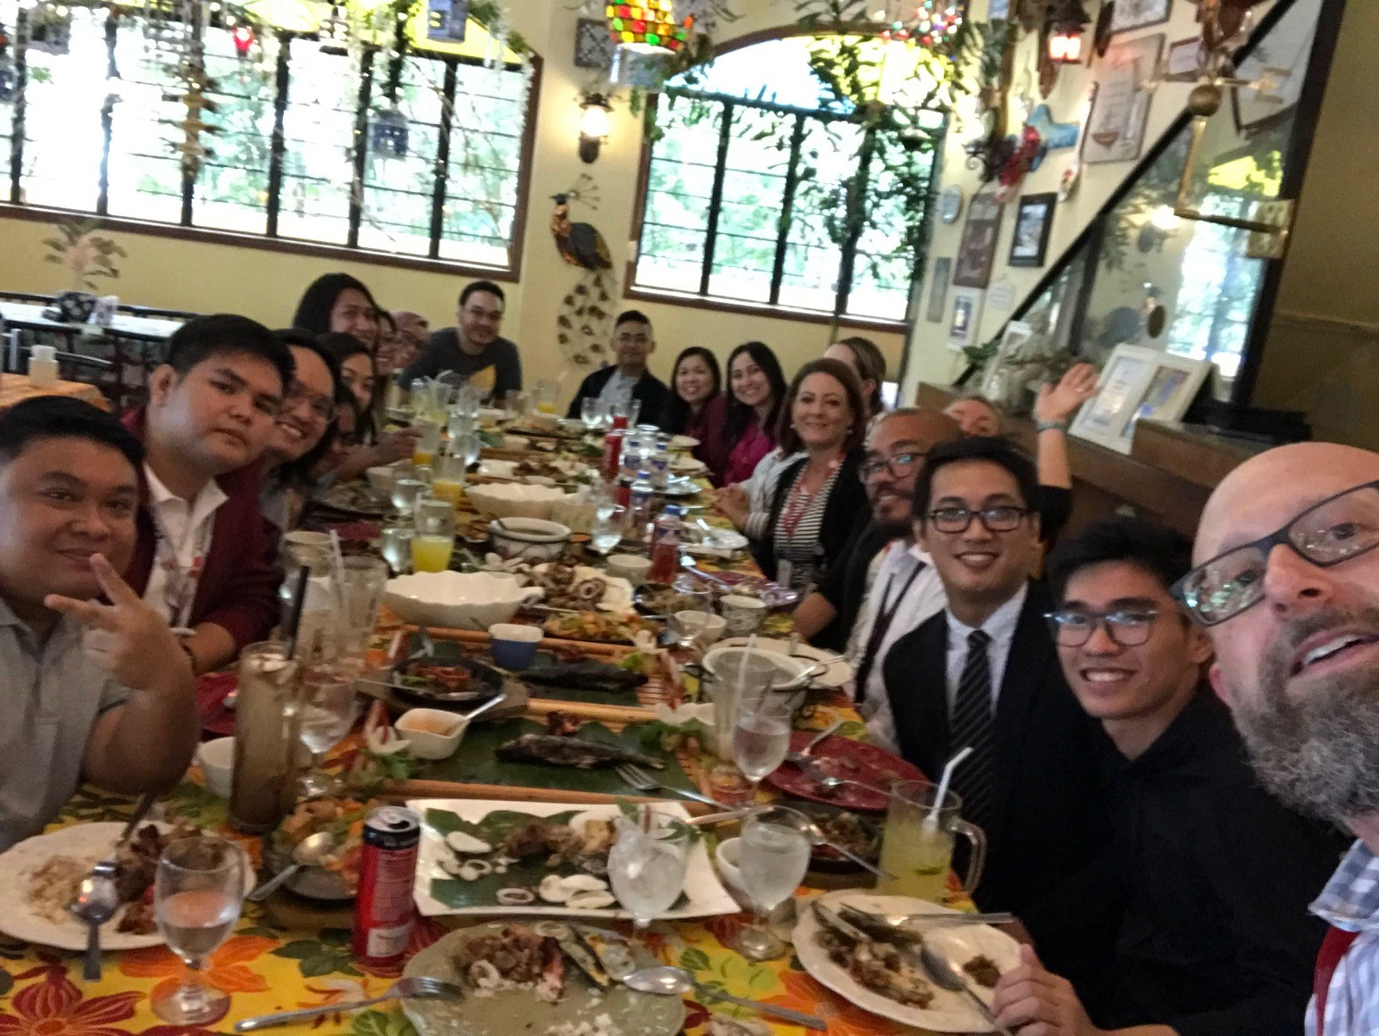
Who we are and what we do
Global Content Strategy
We are team of 14 people
4 in the U.S. and 10 in Manila
18,000 knowledge articles globally
800 - 1,000 requests per quarter

Slide 5
What I’m going to cover today
 | Where we started
 | Our transformation journey
 | Key outcomes
 | Five pillars of an impactful content team
 | Closing
1
2
3
4
5

Slide 6
Where we started

Slide 7
What our users were saying
58% of our content had less than 10 views
53% of users said that they’ve either tried unsuccessfully or have never tried to use content to self-serve
19% of users said that it’s not clear to them how they can use content to self-serve
Our users weren’t happy
I can’t find anything
Content isn’t up to date
Unintuitive search and filtering
Gaps in content
Too much jargon and unclear terminology

Slide 8
Our transformation journey

Slide 9
Our phased approach to
Team Transformation
Centralize and rebrand as GCS
Content Transformation
Implement new standards and templates
Conversational Content
Getting the words right
Content Strategy Modernization
Assess current state, build standards and templates
Notes:
Who: Jazz; Time: 1.5mins
Slide/Talking Notes:
Brief introduction to our team’s journey and then an overview of each stage of our transformation
Team Transformation – post-re-org forming and branding…
Content Strategy Modernization – Assessment, Strategy, and Hominization…
Content Transformation – The journey from transactional to transformational content creation, governance, and standards…
Conversational Content – Improving comprehension, retention, and becoming end-user advocates through conversational design and better information flow…
Handoff to XXX: XXX
Prep Notes:
Feel free to continue working on this slide, visually (maybe larger text?) or leave as-is and I’ll add animation

Slide 10
Key outcomes

Slide 11
We’ve seen improvements in several key areas
Operational Indicators
User Sentiment Indicators
Content Transformation
Portal Experience
Ease of Use
18% to
32% to
51% to
72%
52%
62%
2022
6
Ease of Navigation
Look and Feel
Articles archived
48% to
58% to
62%
67%
Per 1 new article published
Notes:
Who: Jazz; Time: 1.5mins
Slide/Talking Notes:
Brief Intro of improvements by Operational Indicators and User Sentiment / Positive User Indicators…
Operational Indicators – elaborate on each metric a bit
In one year, we went from spending 18% to 72% of our time on content transformation activities (i.e., cleanup, archiving, and alignment to new standards).
By the end of our second year on this journey we were archiving 6 articles for every new article published
User Sentiment Indicators – elaborate on each metric a bit
Overall portal experience: 32% positive to 52% positive response rate
Content ease of use: 51% positive to 62% positive response rate
Ease of navigation: 48% positive to 62% positive response rate
Look and feel: 58% positive to 67% positive response rate
Handoff to Jenn: Now I’ll hand it over to Jenn to talk through our Operation…(what and why does it matter?)
Prep Notes:
…

Slide 12
The five pillars

Slide 13
The five pillars of a high-performing content team
The Five Pillars
1
The Why – Anchoring to your organization’s purpose
2
Team Structure and Talent Strategy – Building a future-ready team
3
Core Behaviors – Setting expectations and reinforcing team norms
4
UX & Conversational Design – Keeping the user at the center
5
Governance, Process & Tech – Leveraging AI to accelerate impact
What do you want to know more about?

Slide 14
Why we exist
OUR VISION
Unlocking limitless value with the most advanced business services
OUR PURPOSE
Powering the people who are changing the trajectory of health for humanity
OUR MISSION
Being a trusted partner, creating game-changing solutions for Johnson & Johnson

Slide 15
Team structure
Global Content Strategy
Content Success
Tactical Execution
Governance & Standards
Three-part structure
Relationships
Execution
Governance & Standards
We drew inspiration from where we needed to be 2-3 years in the future.
We’ve continued to evolve the structure over time.

Slide 16
Thinking outside the box about talent
Key considerations
Skills people need when they walk in the door vs. what they can learn quickly
Traditional content background vs. adjacent fields
Storytelling skills
Experience design mindset
Transformation takes a team with the right mix of skills, willing to try new things, fail and try again.

Slide 17
Our core behaviors are critical to our success
Partner cross-functionally
Ask why
Solve the right problem
Improve the right content
Take ownership
Influence and teach
Be efficient and disciplined
Improvise
Google “Jojo Mayer - A Plea for Improvisation”

Slide 18
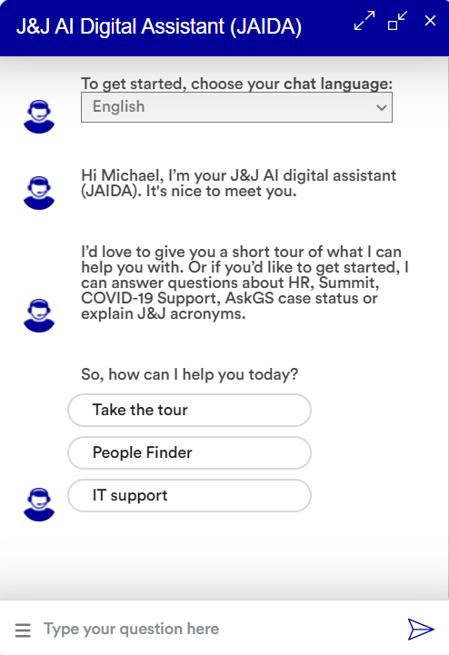
Conversational AI
Digital assistant content development
Workshops and certifications
Persona-based writing
Conversational writing style

Slide 19
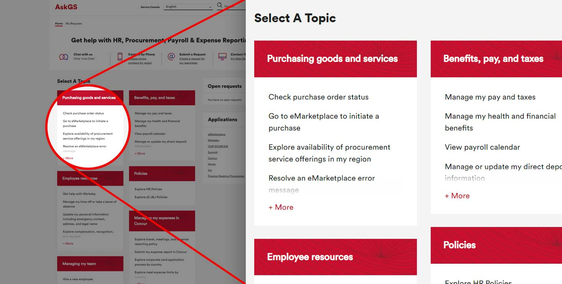
Designing user-centric navigation
Function-focused to task-focused navigation
User-centric terminology
Card-sorting exercise
User testing

Slide 20
Governance and process
Building content transformation into our DNA
Clear content owner roles and responsibilities
Proactive content reviews
Content performance transparency
Quality checks
Leveraging AI to get the words right
Governance
Process
Technology

Slide 21
Leveraging AI to get the words right
Acrolinx is a content governance platform that uses AI to analyze and suggest improvements to our content.
What Acrolinx does
Provides suggestions to improve clarity, consistency, inclusive language, scanability, tone and terminology
Scores content and our content creators
Integrates with our authoring tools

Slide 22
“Deciding what not to do is as important as deciding what to do.”
– Steve Jobs

