Slide 1
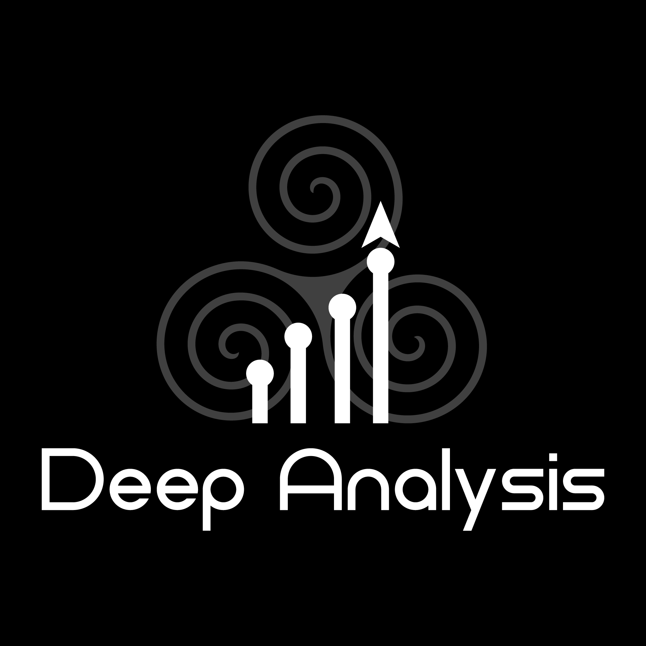
Digital supply chain
www.deep-analysis.net
COPYRIGHT DEEP ANALYSIS

Slide 2
Deep Analysis Focus
Deep Analysis was founded in 2017 to provide strategic advisory services, grounded in deep research into technology buying trends and market dynamics.
We have deep expertise and research in the areas of:
Information Management
Blockchain for Business
Artificial Intelligence
Process Automation
All of our work is steeped in and driven by our research activities. We provide actionable advice and guidance to:
Help enterprises to procure and select the best fit and best cost technologies
Provide insight into new trends to expand your business
Guide your product development and product launches
Deliver competitive insights to position your service for rapid growth
Explore emerging global markets, such as the UK and EU (post-Brexit), Brazil, India and Australia
We also have expertise and deep networks of contacts in the following specific industry verticals:
Supply Chain
IT Services
Regulated Industries
Finance

Slide 3
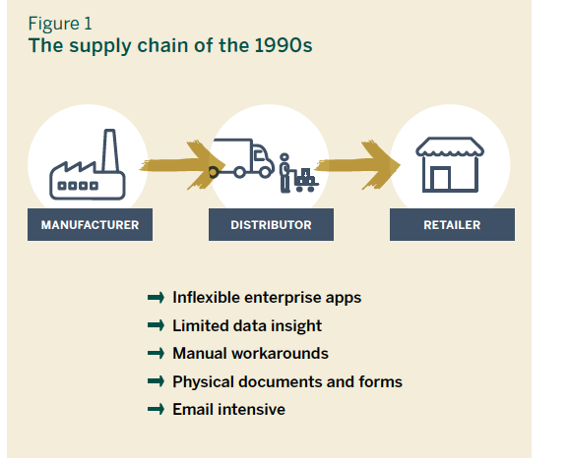

Slide 4
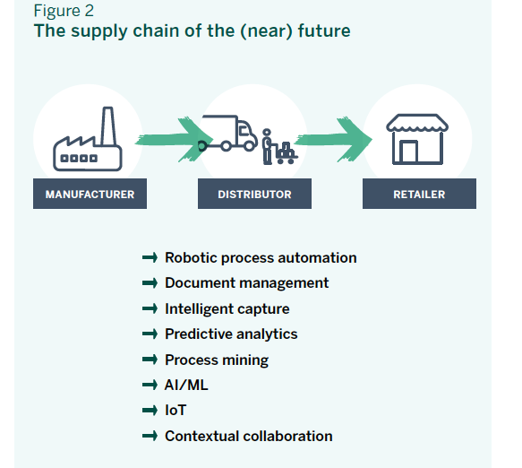

Slide 5
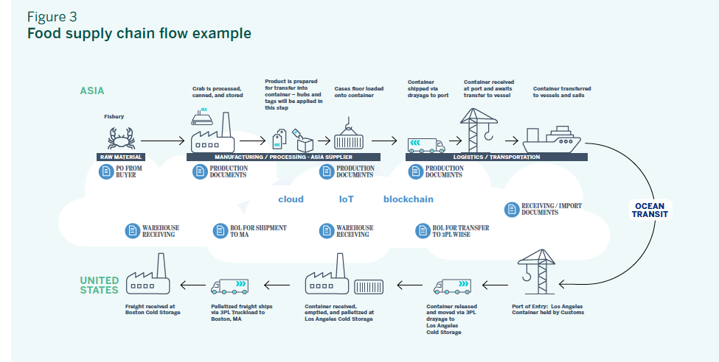

Slide 6
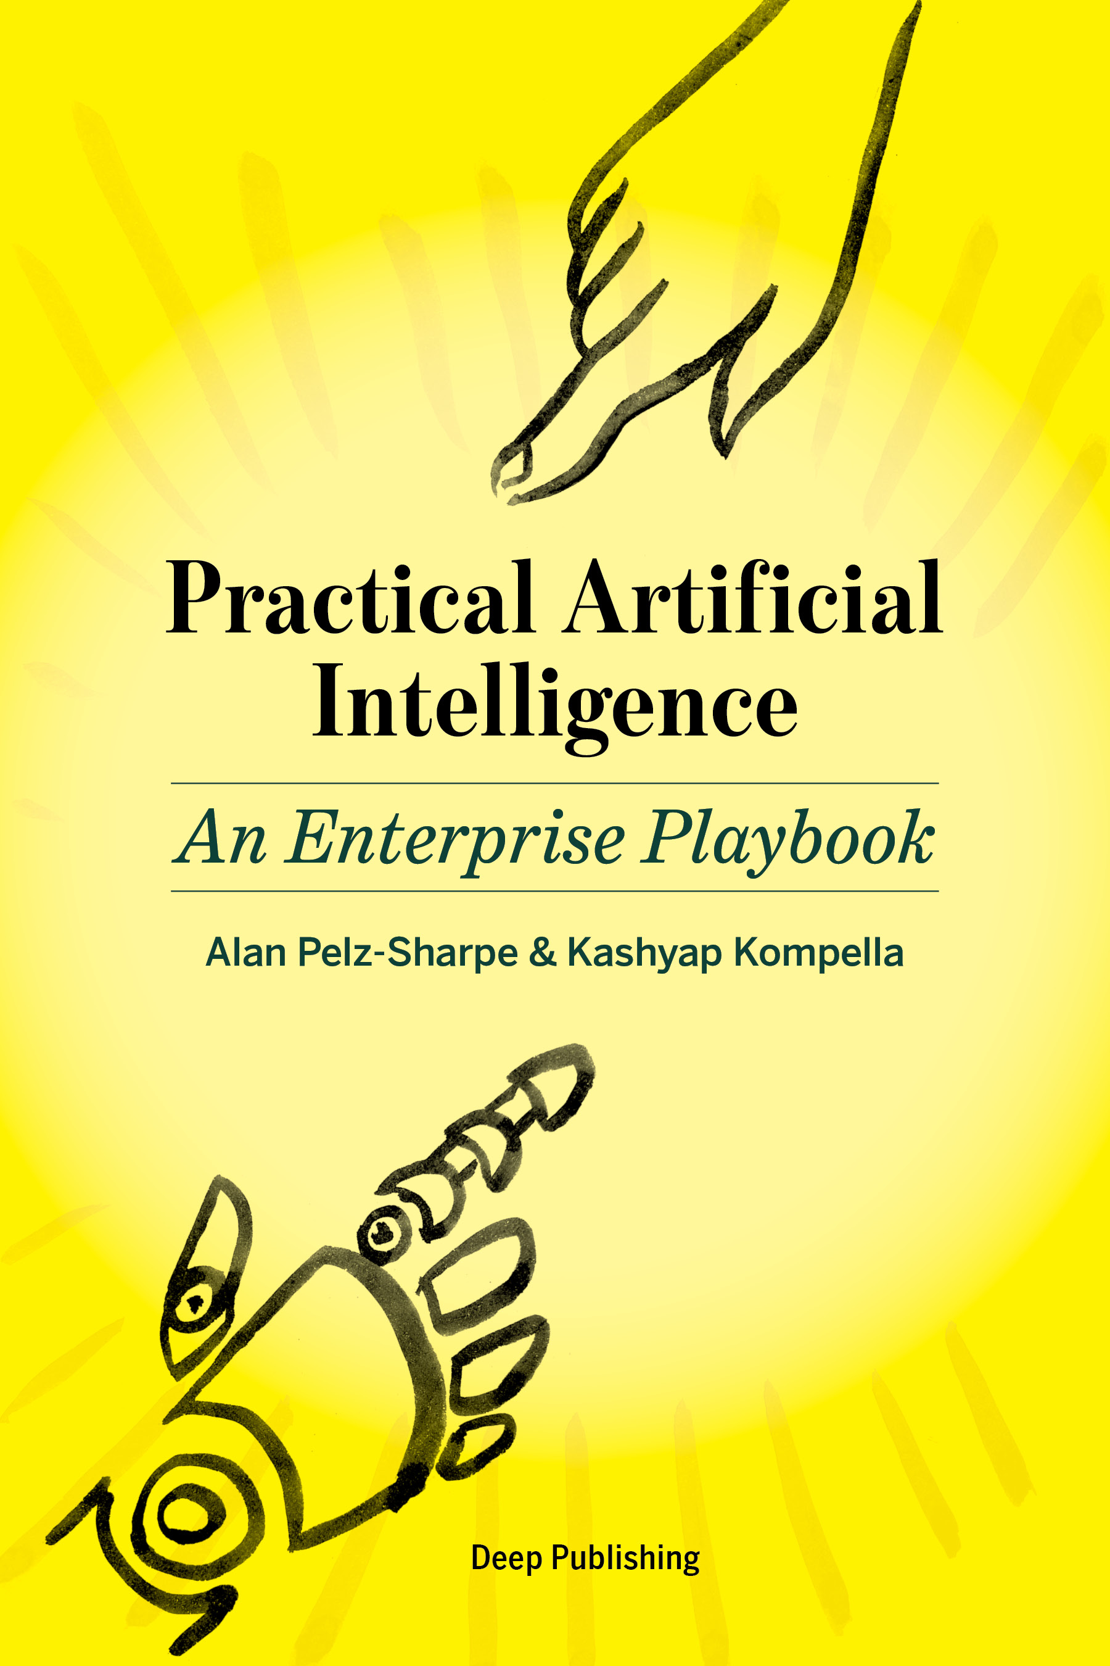
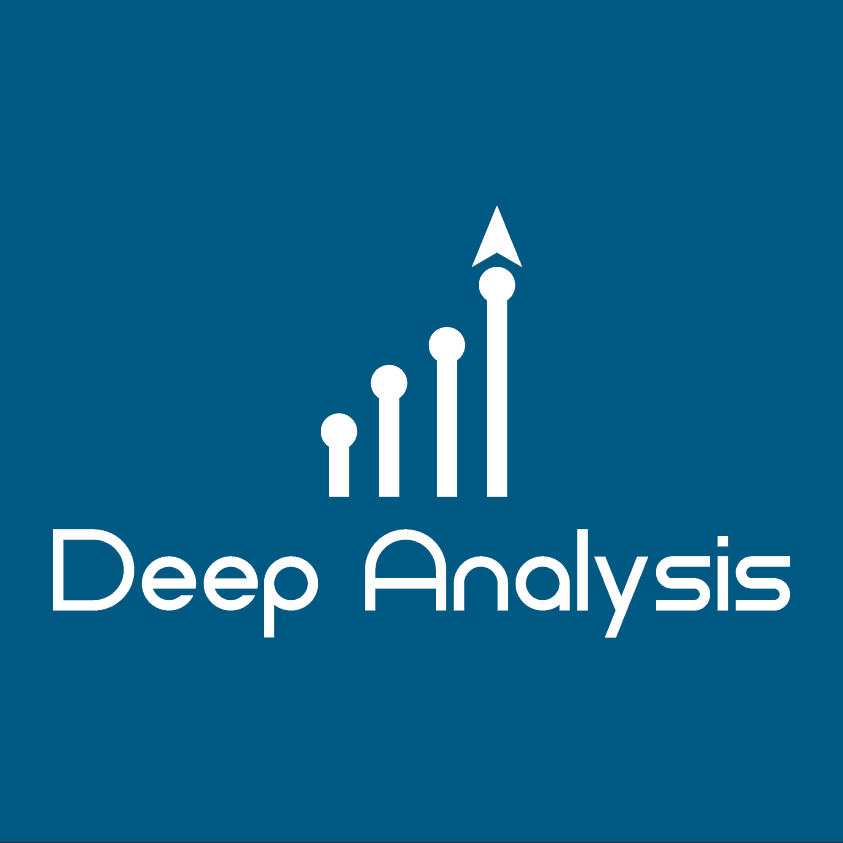
www.deep-analysis.net
aps@deep-analysis.net

