Slide 1
How to look at a form
Caroline Jarrett
@cjforms

Slide 2
Agenda
Let’s look at a form together
How to look at your own forms
What to do to improve your forms

Slide 3

We are going to try to pay for a parking ticket
I’ve chosen Central Bedfordshire where I live
Please
RAISE your hand now
LOWER your hand when you see the page with the form
Make a note of the page number that is the form
(and of anything else that you notice)

Slide 4
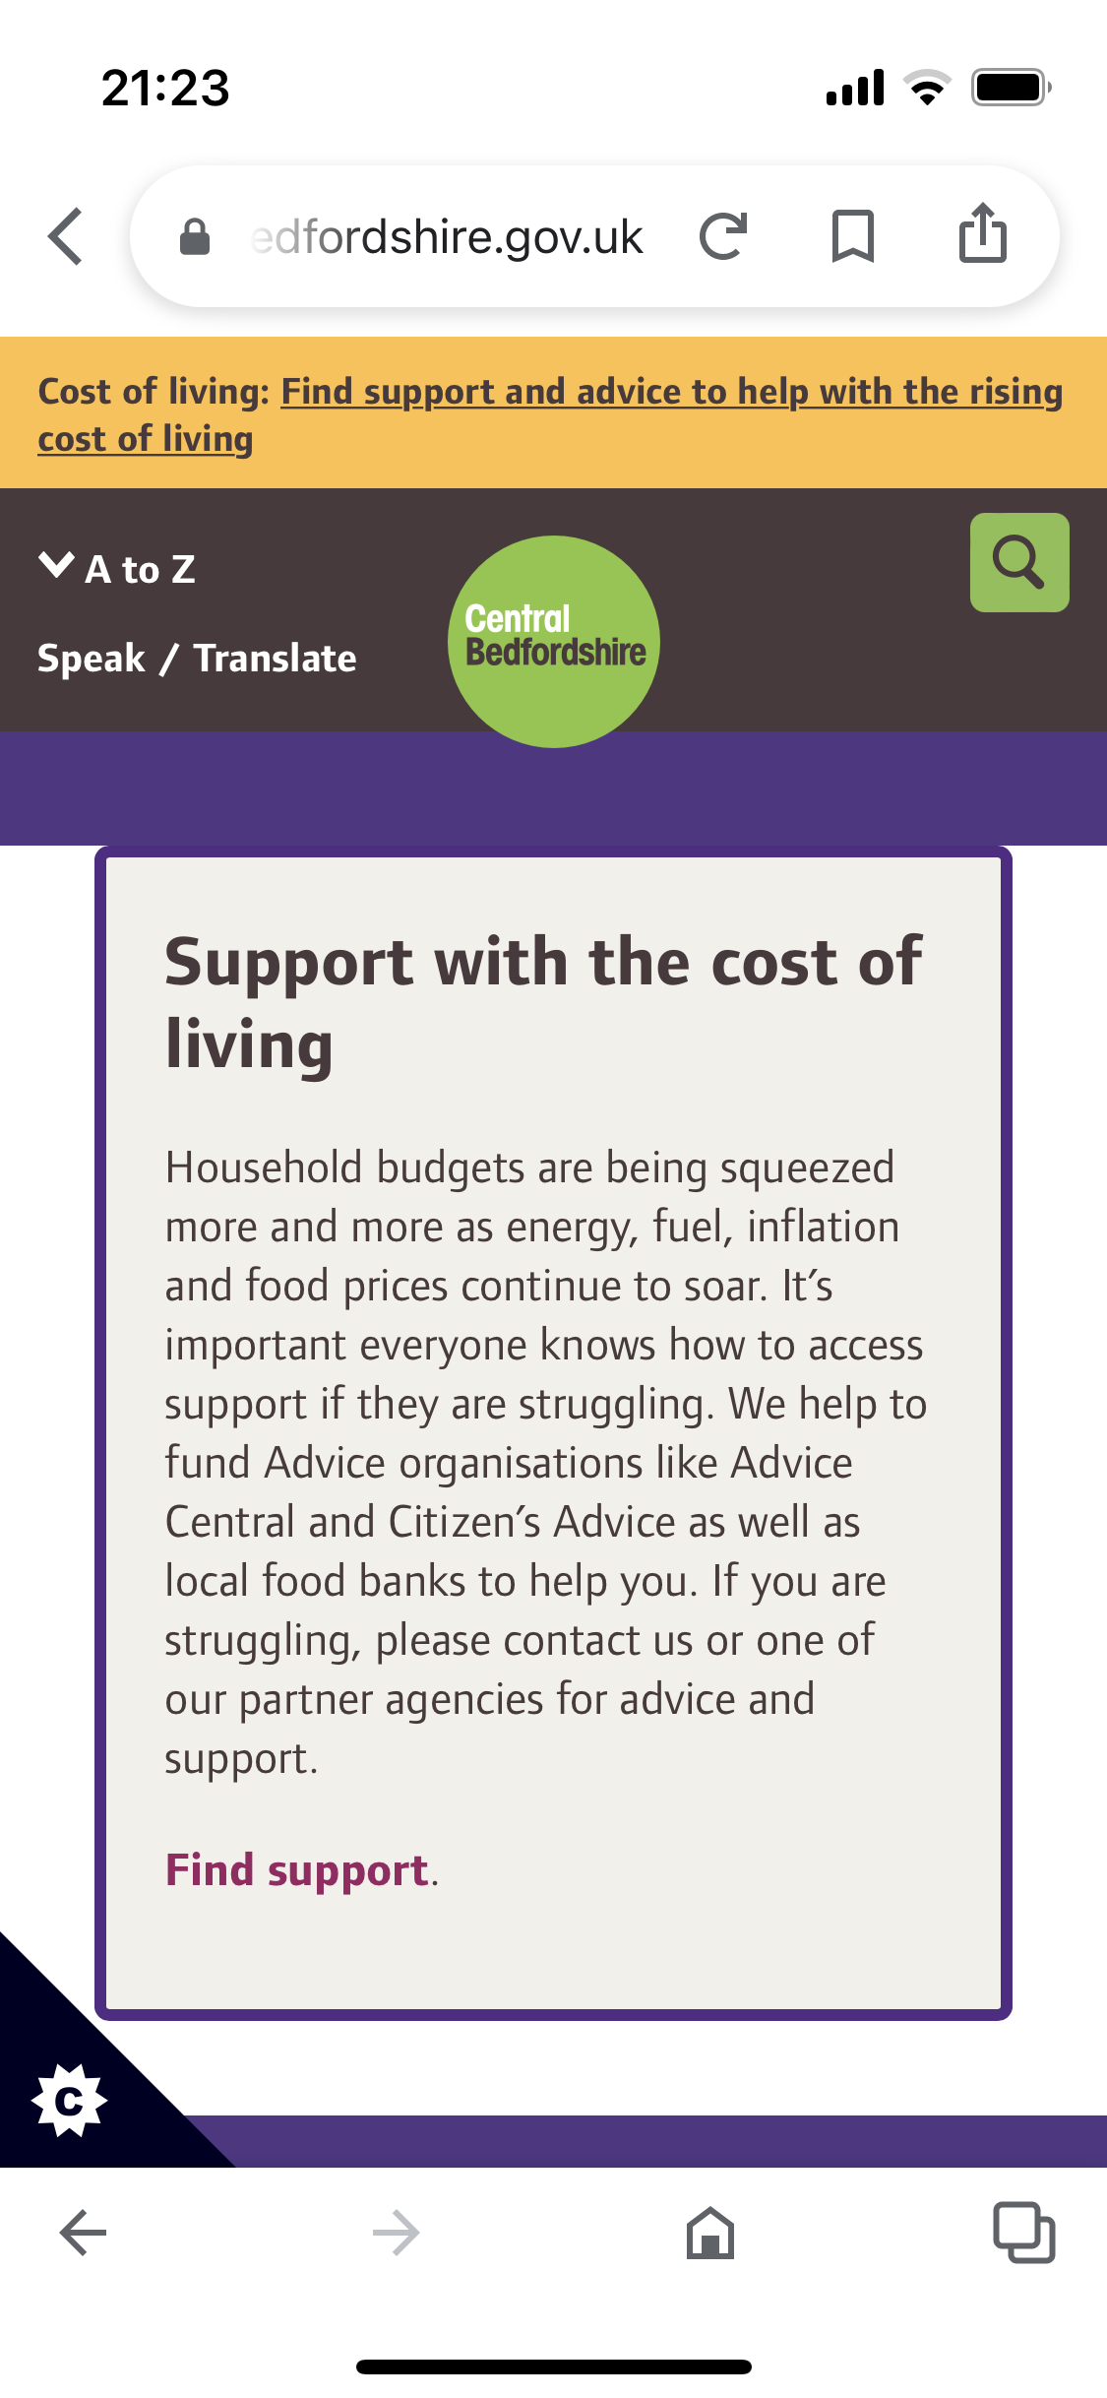
Is page 1 the form?

Slide 5
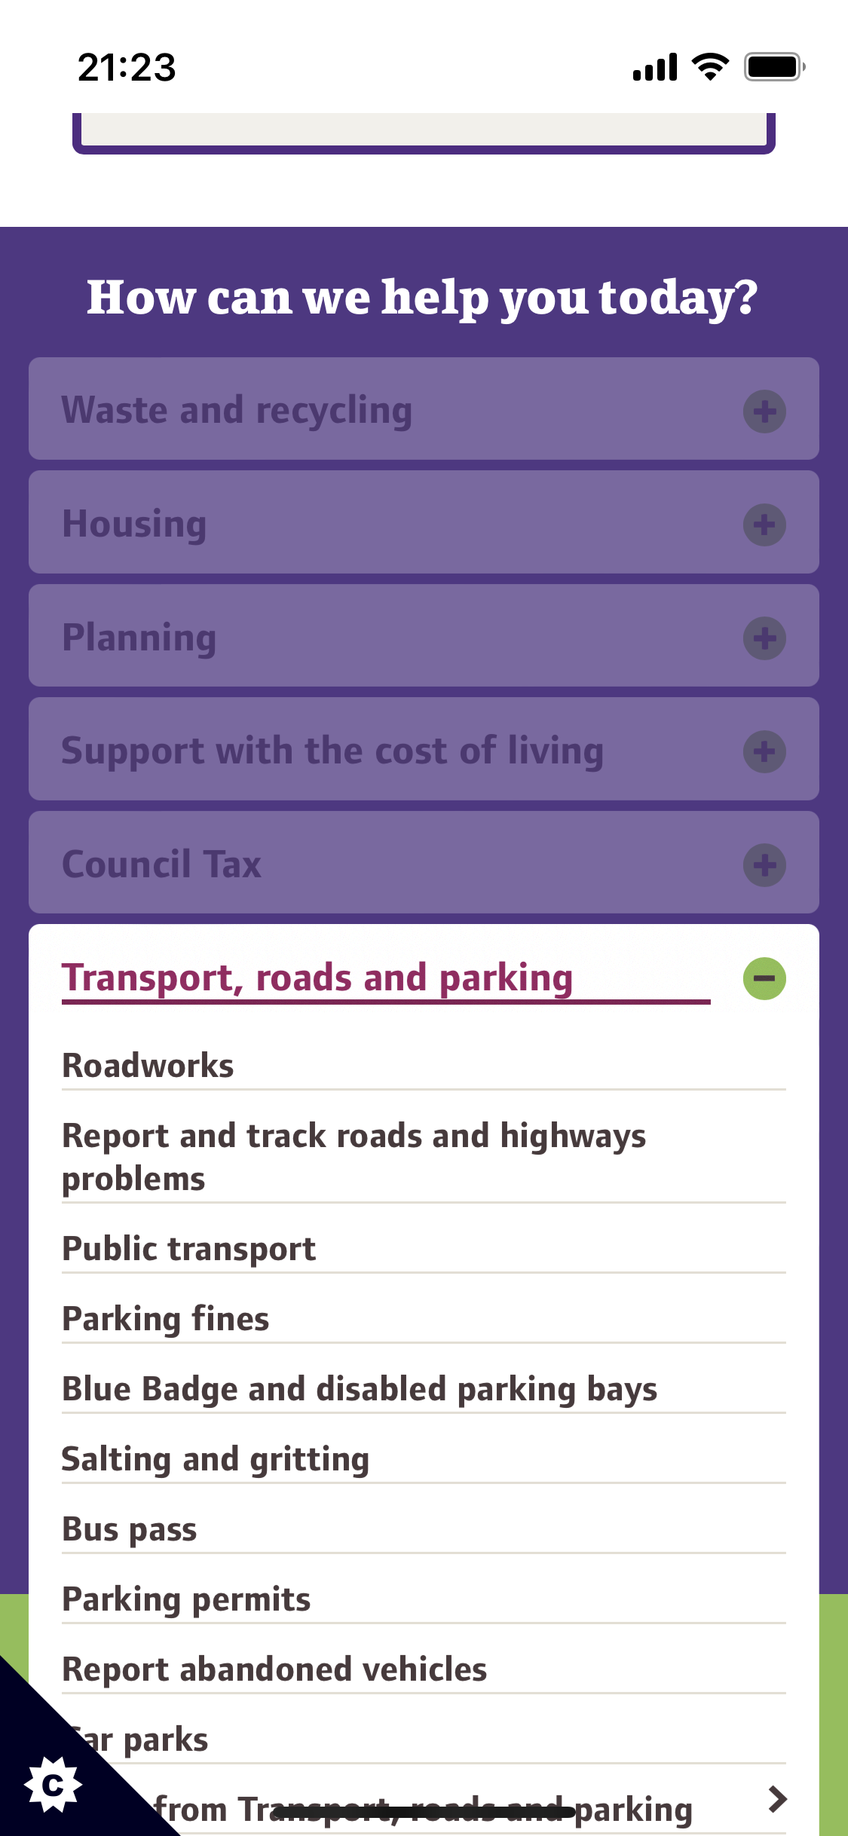
Is page 2 the form?

Slide 6
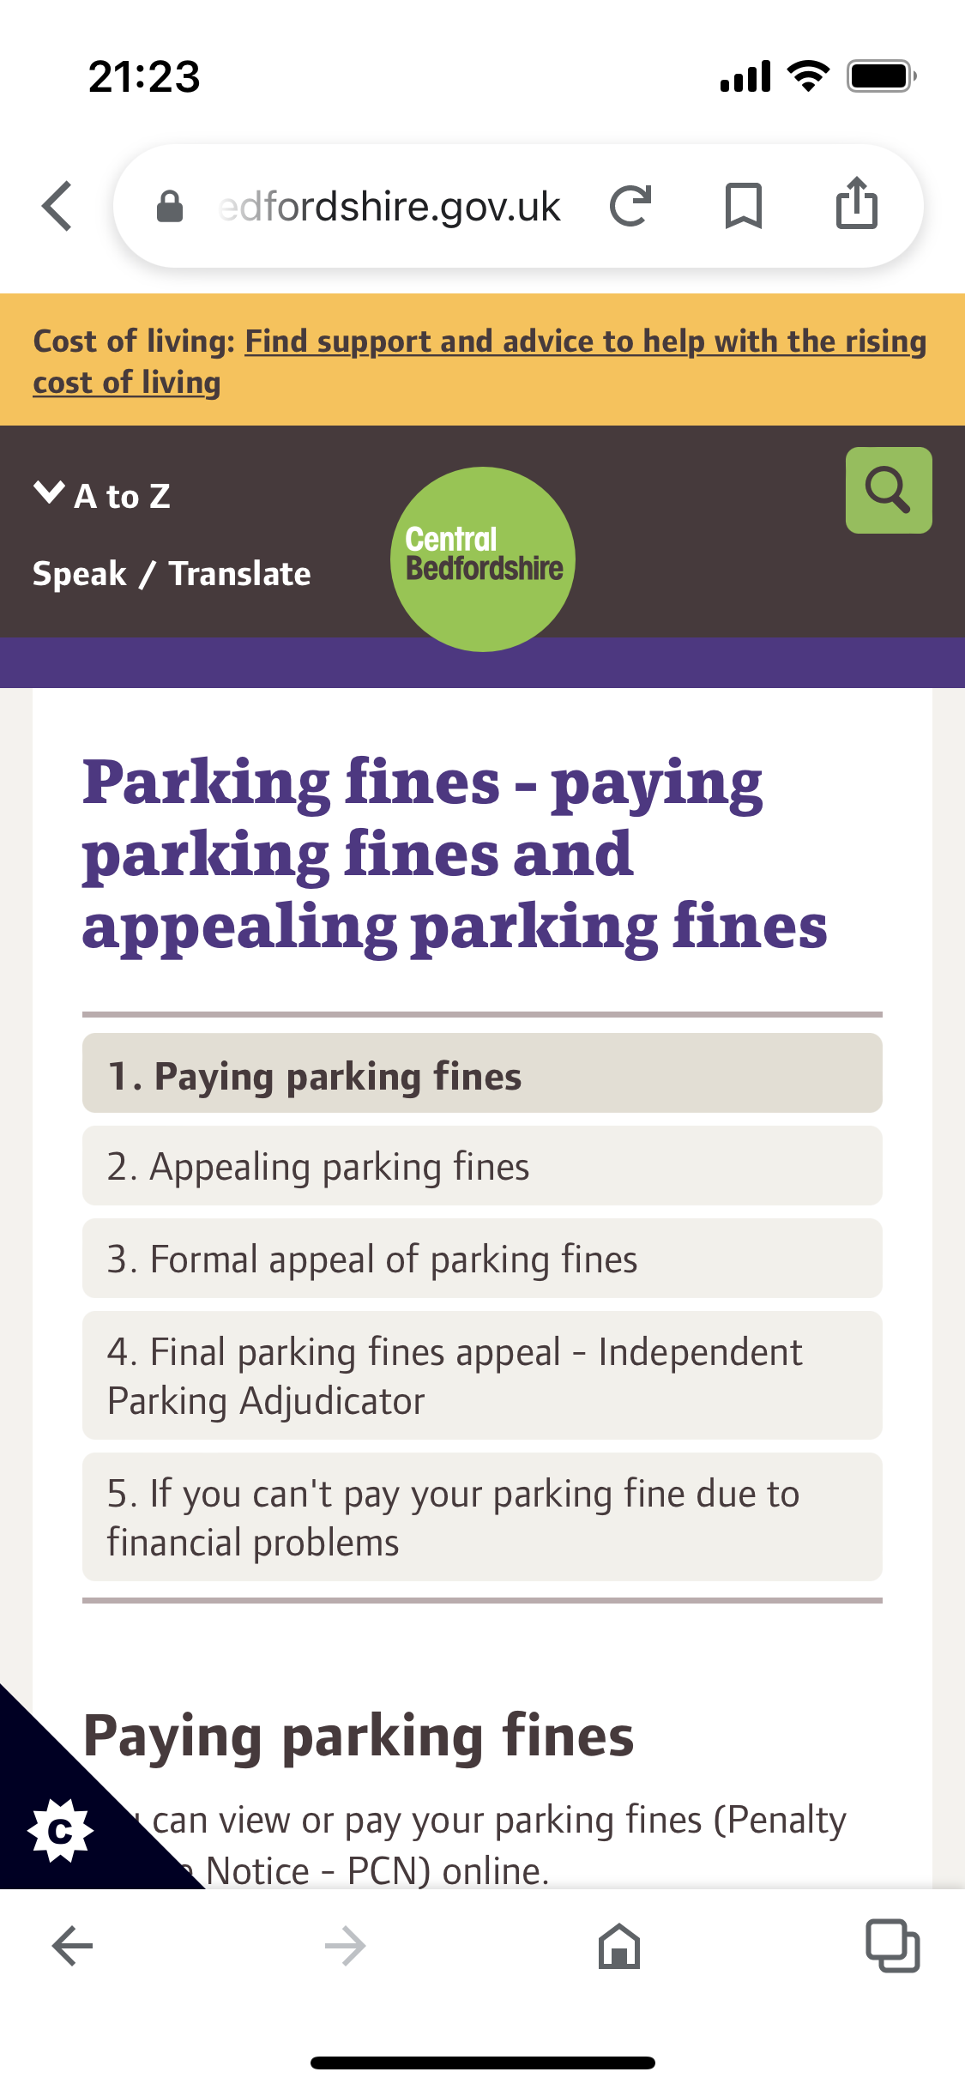
Is page 3 the form?

Slide 7
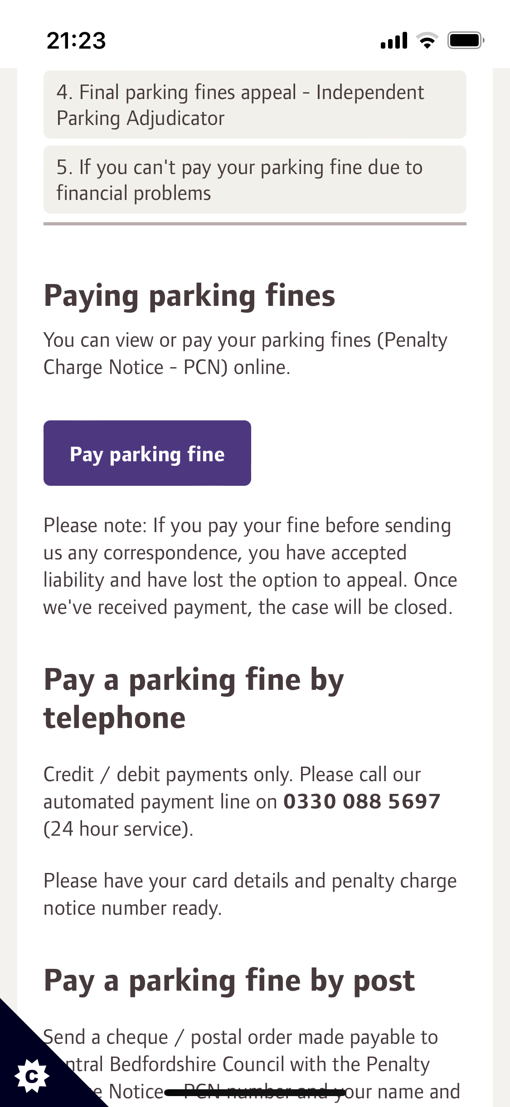
Is page 4 the form?

Slide 8
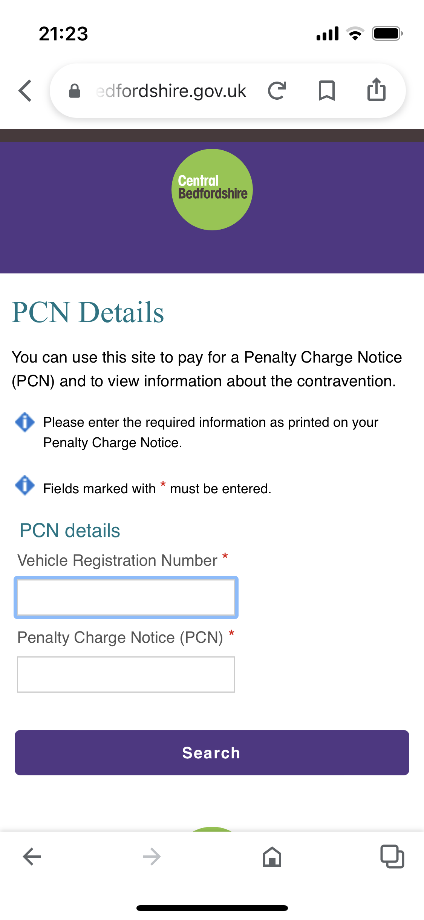
Is page 5 the form?

Slide 9
Let’s focus on these three
5
4
1

Slide 10
We know a form when we see it
Looks like a form and works like a form
Asks questions and expects answers
Allows someone to achieve a goal

Slide 11
A good form needs a lot of design
Looks like a form and works like a form
Interaction design
Asks questions and expects answers
Content design
Allows someone to achieve a goal
Service design

Slide 12
Interaction design: why are these buttons different?
5
4
Narrow button
Wide button

Slide 13
Content design: names keep changing
5
4
Parking fines
PCN

Slide 14
Service design has to account for many priorities
5
4
1

Slide 15
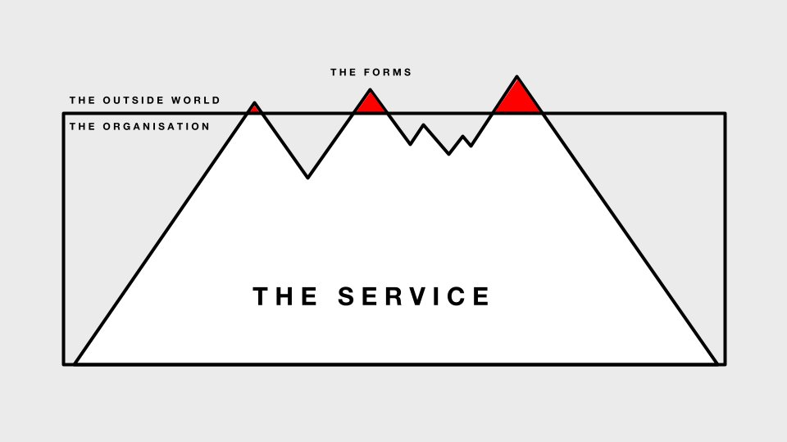
The outside world sees you through your forms
Thought for the day by Tim Paul: a diagram about forms

Slide 16



A good form starts with user and business needs
User needs
Questions you ask
Answers you need
Business needs
Interaction design
Appearance
Content design
Conversation
Service design
Relationship

Slide 17
A good form works well across the layers
Easy to read
Easy to understand
Easy to
get it done
Easy to use
Easy to answer
Easy to
move on
Interaction design
Appearance
Content design
Conversation
Service design
Relationship

Slide 18
Takeaway
A good form is good in three ways
  Easy to read and to use
  Easy to understand and answer
  Easy to get it done and move on

Slide 19
Agenda
Let’s look at a form together
How to look at your own forms
What to do to improve your forms

Slide 20
Are we genuine users of the council website?
Have you had a parking ticket recently?
Do you live in Central Bedfordshire?

Slide 21
There are many stories about parking tickets
“I’m too busy to worry about parking tickets, I’ll pay up”
“I was with my disabled mother who has a special permit, and I didn’t realise that this area didn’t allow disabled parking”
“I was in a hurry to get to a funeral and couldn’t work out how to pay as I don’t have a mobile phone”
“I’ve lost the actual ticket but I know I have to pay”

Slide 22
Step 1: Be realistic about yourself and your users
Be explicit.
  Say exactly who you are going to be when you try the form
  Think about how that person is different from you in real life
  Only be ONE person at a time. You can do other stories later.
Easy to
get it done
Easy to
move on
Service design
Relationship

Slide 23
Step 2: Use the form as the person in your story
Be honest
  If you get to a question where you don’t know the answer, make a note of that
  If you hit any other difficulty, make a note of that
  Don’t stop to look around for problems that someone else might have. Focus on ONE story.
Easy to
get it done
Easy to
move on
Service design
Relationship

Slide 24
Step 3: Go back and think about the three layers
Easy to read?
Easy to understand?
Easy to
get it done?
Easy to use?
Easy to answer?
Easy to
move on?
It’s fine to think of more than one story now

Slide 25
Agenda
Let’s look at a form together
How to look at your own forms
What to do to improve your forms

Slide 26
Expert review is better than no review
Many forms are never tested by anyone, even the person who created them
An expert review based on a reasonably realistic story is better than nothing at all
But we aren’t actually people who (for example) have to pay a parking ticket in Bedfordshire

Slide 27
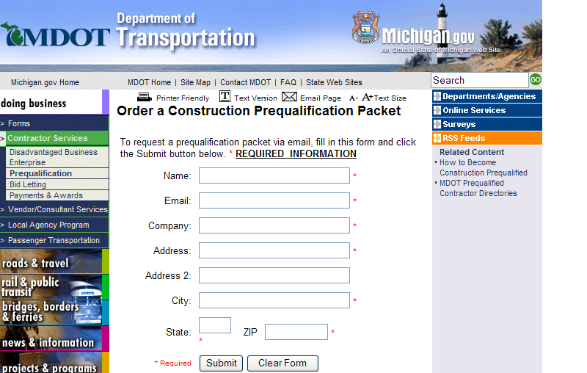
What is the worst problem on this form?

Slide 28
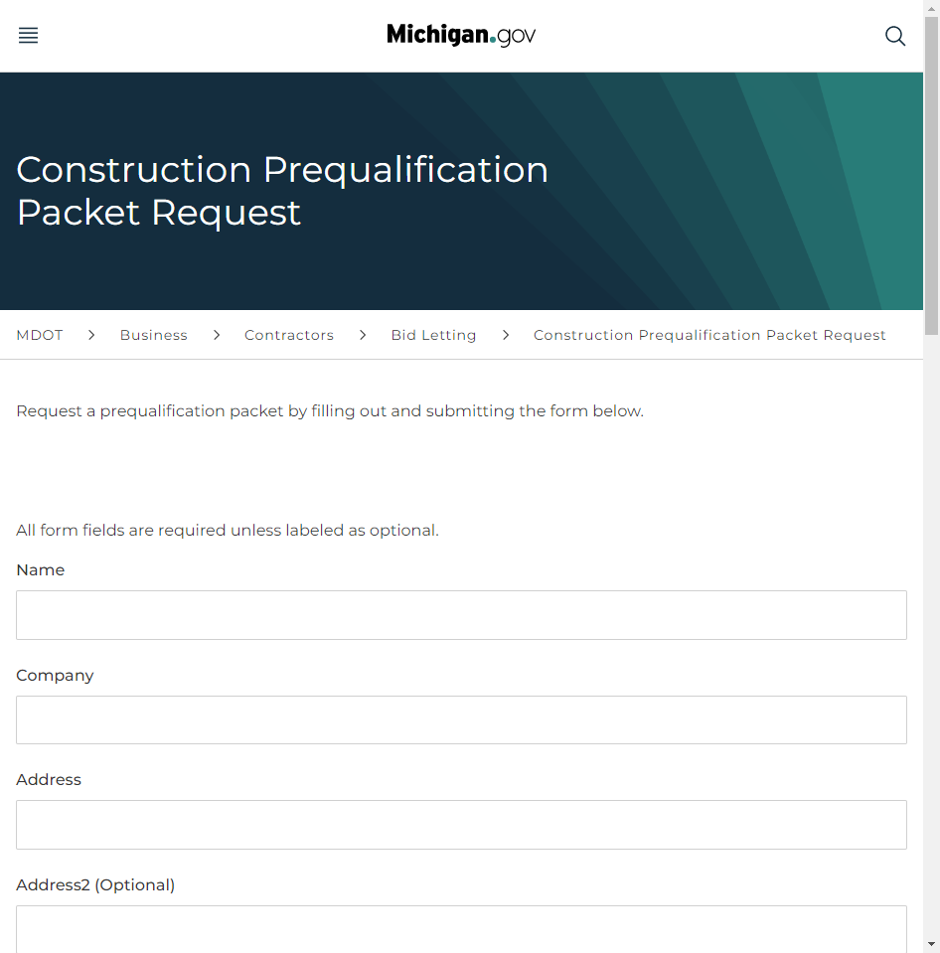
The form looks different in 2022, but the questions are exactly the same
Construction Prequalification Packet Request (michigan.gov)

Slide 29
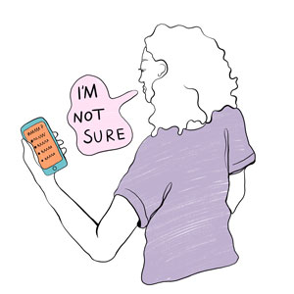
Much better: Do usability testing on your forms
Get someone to fill in your form while you watch
Image credit: Drawn by Tasia Graham, illustration from Caroline Jarrett, “Surveys that work” (2021)”

Slide 30
Then make some changes. Don’t wait.
Set aside a morning every now and then to do some testing
Choose a fix
Make the fix
Repeat
Failing to fix your forms is costing you money - Effortmark

Slide 31


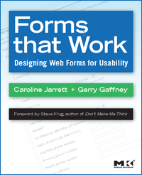
Questions (and contact details)
Caroline Jarrett
@cjforms
caroline.jarrett@effortmark.co.uk
www.effortmark.co.uk

