Slide 1
How to Make Hybrid Meetings Not Suck
What do I have to consider? Preparation and organization Technology
Notes:
Hello there, I‘m gonna share with you
What do I have to consider? Preparation and organization Technology
First up Hybrid Meetings are an emerging practise. Take it easy on yourself.
They are part of an even bigger emerging practice called Hybrid Work so here‘s a really quick insight into how we look at hybrid work

Slide 2
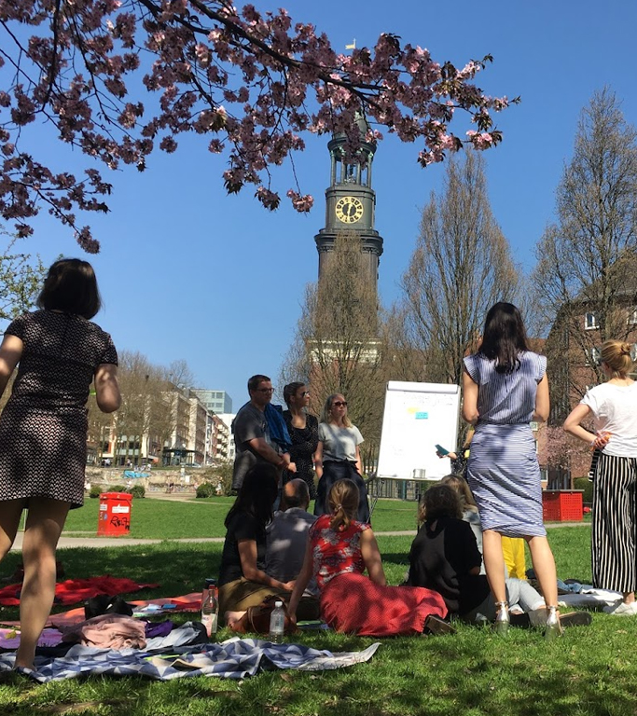
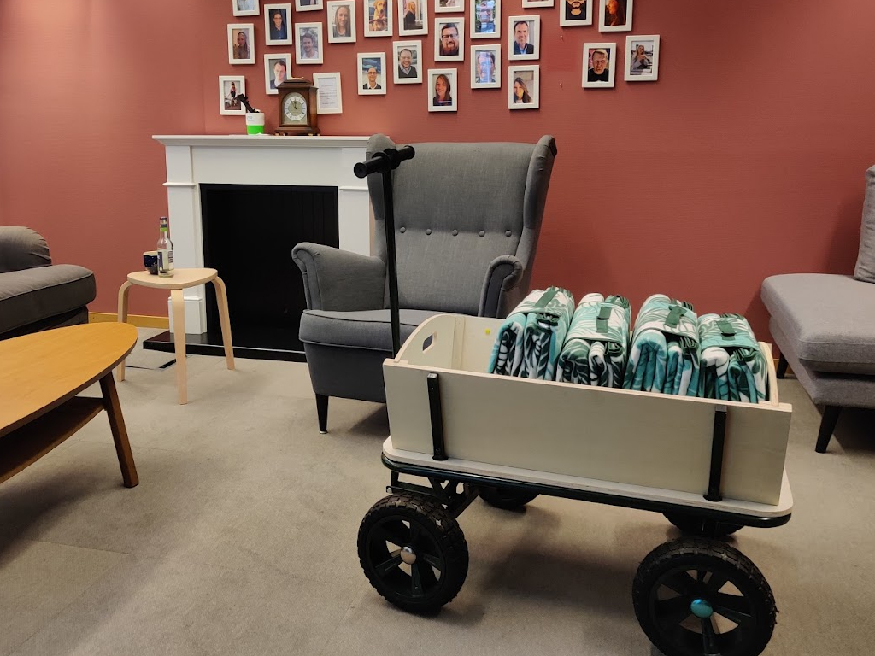
Meetings, asynchronous and focus time
Notes:
For us Hybrid Work/distributed work here to stay.
For a hybrid team model to work, members must trust each other. Behind this is the firm belief that everyone wants the same thing and works together for it. This firm belief is the basis of cooperation. To do this, goals must be named and shared. Overarching goals, project goals, weekly goals, it doesn't matter:
What is important right now? What are you working on together?
Meetings, asynchronous and focus time: A crucial question when it comes to cooperation is whether this work takes place at the same time or at different times. That's why we deal with the three core elements: meetings for the most valuable synchronous collaboration, tips & tricks for asynchronous collaboration and focus time.
Asynchronous work allows you to get into your flow. In which you can carry out the difficult, valuable, meaningful parts of your activity. It leaves us time for reflection.
Focus time is the symbol of asynchronous work. Everyone has their own circumstances, environment and preferences. But one thing is clear: we all need focus time in which we can do what we had set out to do undisturbed. Doing what we wanted undisturbed is satisfying and must be protected.
Meetings are the most common form of synchronous collaboration, but we all know that life is too short for bad meetings. And that counts especially for hybrid meetings
What counts in meetings in the future must be the result more than ever – not the use of elegant conference rooms. In order to create this trust, you need a certain closeness among the members of the team. This has an impact on the meetings. Meetings must not only be for work, appointments must not be squeezed into full days. If in the future employees no longer meet every day, then the days on which they are there must serve the interpersonal more than before. Open times for coffee dates will be more important in the future than putting in work at a desk that could just as well be done at home. These meetings are where new ideas are born, people discover each other for a new form of cooperation, build trust and make friends.
So how do we decide if we should have a meeting at all? The more unclear it is what needs to be done next by whom, the more synchronous collaboration is recommended. This is usually the case with complex or chaotic environments:
We don't know (yet/at all) what to do next. We are in an emergent, highly novel, conflictual, emotional environment.
Synchronous collaboration is almost always organized in form of a meeting or workshop. For the sake of simplicity, this also includes coaching occasions or crisis talks or relationship work in general. Joint brainstorming, topics with a high degree of novelty (and correspondingly high uncertainty factor with regard to goals or terminology) or particularly time-critical topics can be good examples of synchronous work. Synchronous collaboration is best done in a meeting. Even with small amounts of synchronous work, it can be helpful to conduct a meeting when the focus is on building or strengthening trust, belonging, or appreciation. Another factor influencing the application synchon/asynchronous can be the maturity level of a team (low maturity level > rather synchronous).

Slide 3
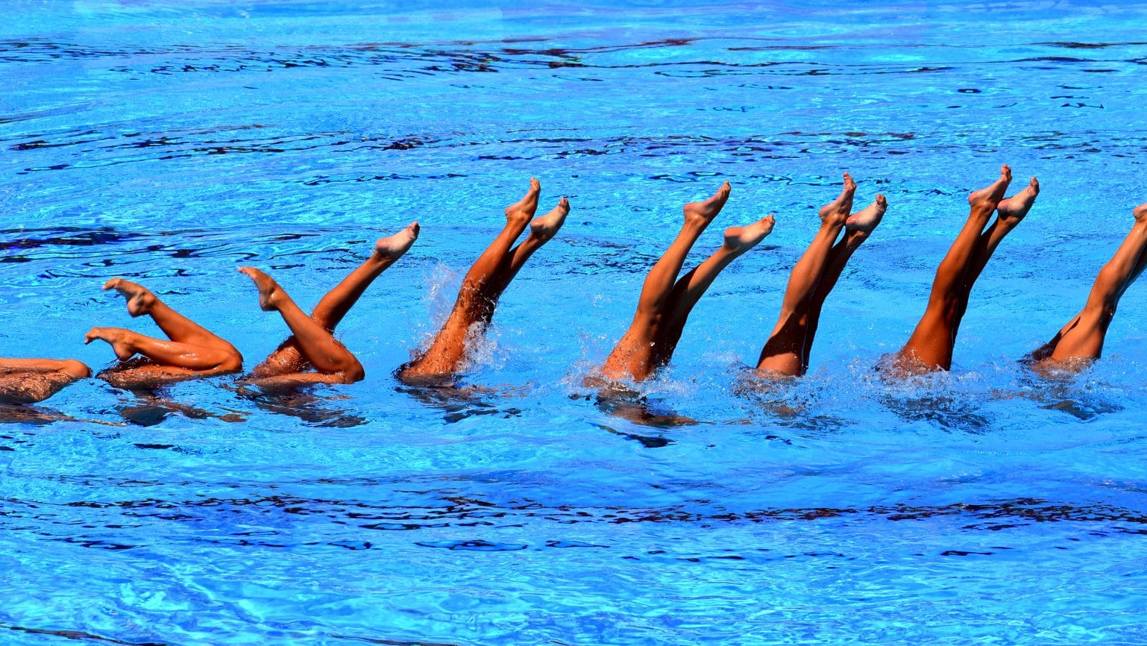
About the benefits of synchronicity and async in collaboration
This Photo by Unknown Author is licensed under CC BY-SA-NC
Notes:
Why bother with async at all? async is a lot about inclusivity. Companies that make it possible to do most work asynchronously allow people to optimize their everyday lives for their lives, not for their work. They can plan their days according to the needs of their families, not the needs of their colleagues. They can work during their most productive hours or use a nonlinear workday, creating a new paradigm of flexibility. Furthermore, an increase in efficiency can be achieved with async. In addition to classic efficiency, asynchronous working also offers the potential for new forms of creative work Asynchronous work allows you to get into a flow where knowledge workers like most of us can perform the more difficult, valuable, meaningful activities. It creates space for reflection of the work. The symbol of asynchronous work is focus time.

Slide 4
Meeting
The more synchrone the meeting
Asynchron
Synchron
Inform
Decide
Adapt
Notes:
"How can I do this work without having to call a meeting?“
Inform: Information should primarily be shared Decide: Binding decisions should be made and documented Adapt: The main aim is to develop learnings from previous cooperation and to derive measures from them. Meetings with a high information character must be questioned as to whether they cannot be diverted into asynchronous information transfer. Meetings in which decisions should be made must be prepared in such a way that the information part can be consumed asynchronously and a preliminary clarification of comprehension questions is possible. There is potential for discipline here, insofar as the information must be consumed by everyone in advance and is not reissued by default in the meeting. If the cooperation is to be discussed together (work on the system), this is usually best represented by synchronous cooperation (→ i.e. meeting).

Slide 5
Life‘s too short for bad meetings
Notes:
So meetings… they are a form of collaboration. Advantages:
All participants come together at the same time Possibility of effective joint processing / strengthening of cooperation
Disadvantages:
All participants must come together at the same time as a rule, high resource consumption by the participants is recorded (e.g. 1 hour meeting with 5 people = internal working time worth at least 500€) High structural impact: Many meetings can result in too little time for unstructured, individual work for the people involved.
Meetings as one of the most used forms of synchronous collaboration, are the most valuable time we have together at work
We want to provide clues on the basis of which you can decide
Whether you should work synchronously or asynchronously: For which type of (cooperation) meetings are suitable (best practice) Which form of a meeting best suits your goal Whether a hybrid meeting format is suitable What to consider in hybrid meetings (distributed teams) (Emerging Practice) To the meetings, esp. In hybrid formats, we want to provide tips and tricks on how to do these particularly well. Because: Life is too short to spend it in bad meetings.

Slide 6
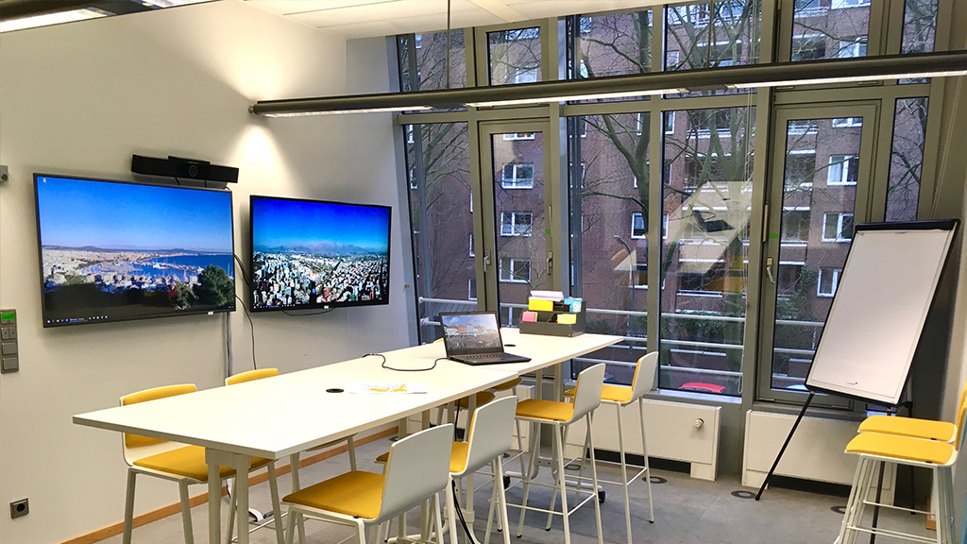
Flipcharts are so pre-pandemic
Notes:
Here are a few tipps_:
Make sure that everyone has the same conditions as possible. These include, for example:
Agenda visible Image: Visible to and for all Moderation, preferably one each for online and face-to-face participants Agree on whether and if so how to deal with hand signals All with laptop in the meeting, e.g. for shared documents (see below) Shared whiteboard Minutes taken during the meeting Optional: Recording Optional: Session Evaluation, Meeting Meter, TimeBoxing
One remote, all remote? That doesn't have to be the case. However, it is advisable not to create glaring imbalances: all but one on site? Then this one person has to be brought on a large screen in order to be able to develop a good presence (see technology, next page)
As a moderator/organizer:
start appointment a bit in advance, usually good space for small talk ensure transparency in decision-making so that no group has the impression that it is somehow not being heard Make summary regularly/ observe interim results take "camera off" moment, sometimes the best things come shortly after the end
If you regularly lead hybrid meetings, switch between the leadership as a roomie and as a remote
To avoiding multitasking during meetings:
Best time after noon The longer a meeting and the more participants, the higher the likelihood that participants will do something else in the meantime

Slide 7
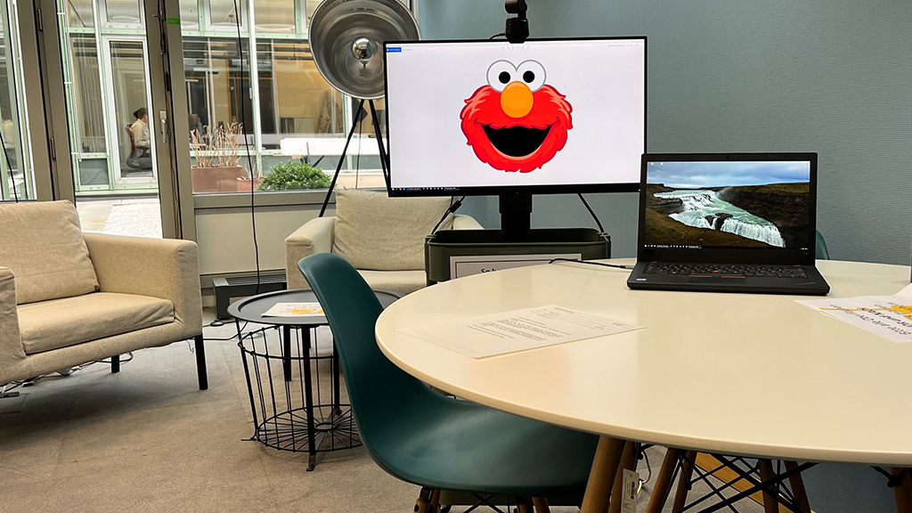
Meet Elmo
Notes:
One remote, all remote? That doesn't have to be the case. However, it is advisable not to create glaring imbalances: all but one on site? Then this one person has to be brought on a large screen in order to be able to develop a good presence (see technology, next page) As a moderator/organizer start appointment a bit in advance, usually good space for small talk As a moderator/organizer, ensure transparency in decision-making so that no group has the impression that it is somehow not being heard As a moderator/organizer regular summary / observe interim results As a moderator/organizer take "camera off" moment, sometimes the best things come shortly after the end Avoiding multitasking during meetings: Best time after noon The longer a meeting and the more participants, the higher the likelihood that participants will do something else in the meantime If you regularly lead hybrid meetings, switch between the leadership as a roomie and as a remote

Slide 8
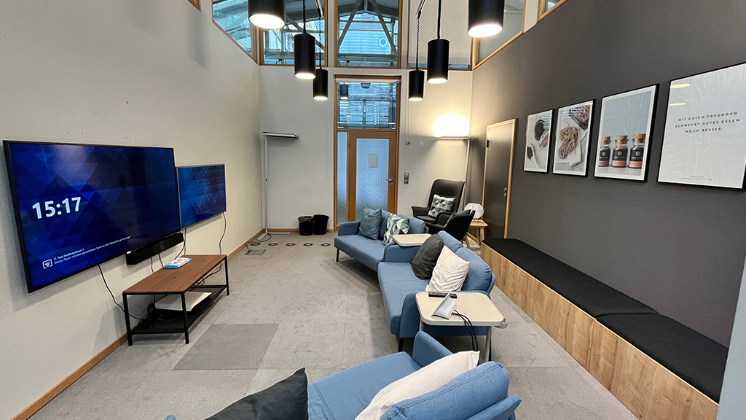
What’s annoying in remote meetings will kill you in hybrid
Notes:
Technically, there are also a few things to consider that can create equality:
Semicircle as a new hybrid seating arrangement Automatic camera tracking On-prem must be attractive Good equipment at home The remotes should see all attendees, but at least the one or the one who is speaking. An intelligent camera can be helpful for this – or a person in presence takes over the function of the camerawoman. Likewise, all remote participants should always be visible to the participants in presence. For this purpose, these should be transferred to a large screen and not just stand on a tablet on the table. Two to four participants can be easily recognized on a screen, so that even remote participants can recognize them well. When working together on documents in distributed meetings, it is advisable that all participants, including those on site, dial into the teams meeting and follow what is happening on the document on their laptop or on a second large screen. If there is only one large screen, the remote participants can always be seen. The use of paper should be avoided. This applies to flipcharts, post-its etc. All this must be digitized. The use of paper discriminates against Conference speakers and microphone, use meeting owl, advance check is recommended. Lighting conditions: Make sure that faces are clearly visible, not a large, bright light source in the background (e.g. windows)
Whiteboard/Miro can help to conduct even prepared, larger meetings and workshops

Slide 9
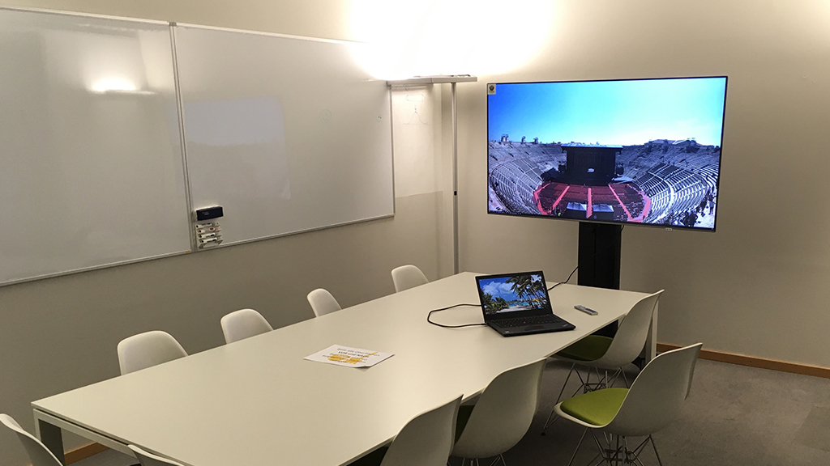
The Biggest Don’t for Hybrid Meetings?
Donuts for the Roomies
Notes:
A laptop perched at the end of the table whose screen shows the video feeds of the remote participants.
The laptop webcam shows the remoties a "bowling alley view" of the roomies, and the microphone and speakers provide the only audio facilities in the room. That never works. The Remoties can't hear or see what's going on, they can't understand a word, and it ends horribly — and exhausting — for everyone. Paper in the room: Before a Remotie even tries to decipher what you write on Post-Its, he is already so demotivated that the camera goes out and someone gets a good coffee. Do you want to quickly ruin the atmosphere in a hybrid meeting? Provide delicious-looking refreshments and cookies for attendees in the office in full view of the remote attendees! Share the results of the meeting in different forms, depending on whether someone was in the room or remotely.
So to sum it up

Slide 10
Presence (remote)
The bumpier the presence
Distributed
Familiar Team Trust
Familiar Processes
Factual Issues
New, Unfamiliar Team
Processes unknown, New Topic
Conflict, Emotion
Notes:
When to not do a hybrid meeting at all

Slide 11
Being good at Hybrid Work is a chance.
The opposite is a risk.
Thank you

