Slide 1
Content that Connects
Creating a Content Model that supports a Multichannel Strategy

Slide 2
The journey
From code-craft obsession to content-driven

Slide 3
Going headless
Headless architecture
Fortune 500 B2B Supplier
$5MM per day e-com sites
Content reuse
Shift to content modeling

Slide 4
Developer mentality
Structure data – I got this!
Focus on pixel perfect design
Coding a masterpiece
Models serving code & design

Slide 5
Milestone 1.
Author experience
Developer-think creates an awful author experience

Slide 6
Design-by-engineer trap
Design-system thinking
Atomic design, page layout
Small reusable structure
Repeated patterns
Encapsulation, encapsulation, encapsulation
Result
Small subatomic pieces of content
Elegant reusable code
Overboard
Page
Banner
Big Quote
Author
Section
Card 1
Card 1
Card 1
Card 1
Headlines
Feature 1
Sec. CTA’s
Card 1
Card 1
Card 1
Card 1
Card 1
Card 1
Subtopics
Topic 1
Card 1
Card 1
Card 1

Slide 7
Demo horror, author pain
Many pieces, many clicks
Cumbersome content organization
Ultimate reuse, created difficult reuse.

Slide 8
Walk in the author’s shoes
Try the entire authoring process – often!
Author-experience more important than code experience.
Content models should honor content meaning.
Serve the content not the code.

Slide 9
Milestone 2.
Connected models
Ensuring content is manageable & deliverable

Slide 10
Illegible content
Secret decoder ring required
Content meaning obscured
Brittle reverse-engineering

Slide 11
Connected model types
Fragmented types
Links
Label
Caption
Title
Heading
Connected types
Article
Location
Product
Question & Answer
Testimonial

Slide 12
Milestone 3
Semantic models
Ensuring content is understandable and reusable

Slide 13
Semantic Types
Semantic
Non-semantic
Benefits
Discoverable
Content reuse
Independent
Redesign survival
Types
Types
Service
Product
Promotion
Location
Testimonial
Slider
Layout Block
Media Block
Teaser
Card
Attributes
Attributes
Related heading
Related links
Summary
Side rail title
Side rail links
Intro copy

Slide 14
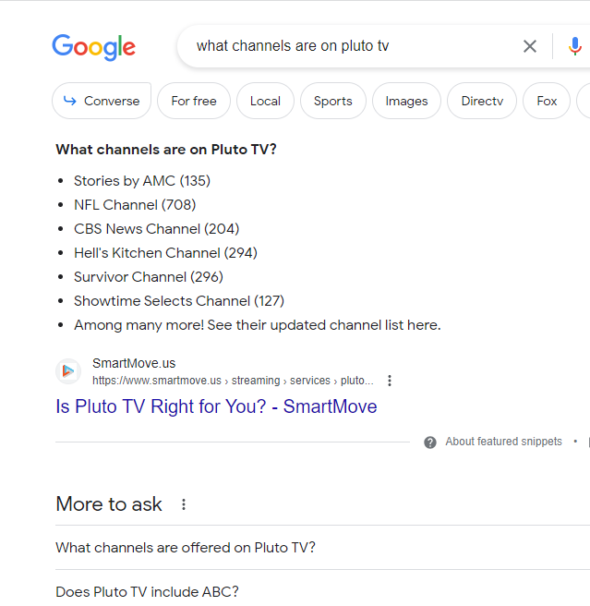
Semantic content empowers bots
Semantic types can be mapped to Schema.org structured data
Types:
Product
Review
FAQPage

Slide 15
Milestone 4.
Content Strategy
Reaching the right audience with the right message.

Slide 16
Content strategy
Audience
Goals
Delivery channels
Types of content

Slide 17
Delivery channels and rapid changes
Tried and true
Websites
Emails
Social media
Yesterday’s news
Search snippets
Voice searches
Beyond imagination
AI-enabled search
Generated summaries
Bing, where are B2B buyers consuming content?

Slide 18
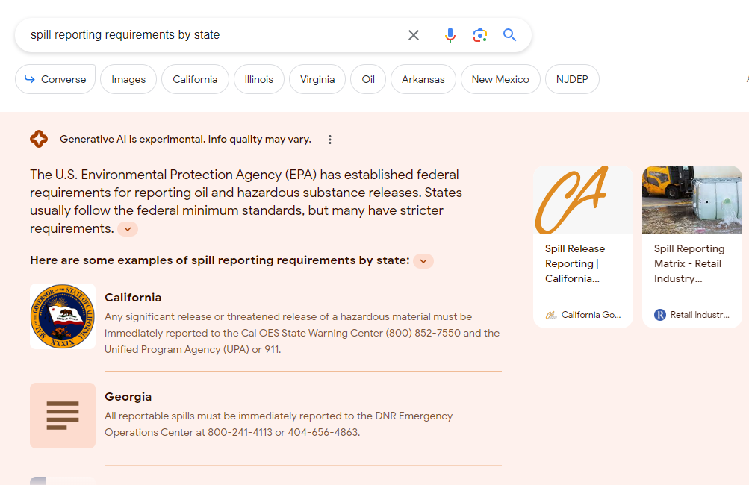
AI-powered summary
A resource sheet found its mark

Slide 19
Search snippet
Loan guide reaching coveted search snippet

Slide 20
AI summary.
Search-integrated Bing Chat summary

Slide 21
Table questions

Slide 22
Content that Connects
From excitement to real business impact
Why is a content-centric strategy important to our clients’ businesses?
How do we change standard "redesign" processes to define and maintain a content-centric strategy?
How do we guide our clients to think about content beyond their websites?
How do we train developers to think about content strategy and authoring first?
What features or functionality should platforms have to help with this?
Notes:
We get jazzed,
How …get clients to think about this differently?
Relate to business impact
they can't see that now.
How do we help them?
We get excited about cross-channel marketing
Clients … still thinking about content … website
Maybe email and certainly SERPs.
Next 15 minutes
Move from talking about .. Conceptually
To sharing stories about how we've put it in action.

Slide 23
Leveraging AI requires content quality
Content visibility in AI-enhanced search engines can be boosted up to 40% by increasing content quality.

Slide 24
AI-enhanced search optimization
Improve by 30-40%
Cite reliable sources
Add credible quotations
Add relevant statistics
Improve by 15-30%
Simplify content – make it easy-to-understand
Improve fluency – make it more articulate
Research: https://openreview.net/pdf/d7aef3973d67b5dcaf1b84b76042e9ff6a705d3b.pdf
Summary: https://www.searchenginejournal.com/researchers-show-how-to-rank-in-ai-search/504260/
Notes:
Secondary strategies (15-30% improvements)
Fluency optimization
Easy-to-Understand methods
https://www.searchenginejournal.com/researchers-show-how-to-rank-in-ai-search/504260/
https://openreview.net/pdf/d7aef3973d67b5dcaf1b84b76042e9ff6a705d3b.pdf
Anonymous authors
Paper under double-blind review

Slide 25
Thanks!
Any questions?
Find me at @heymikewills & mwills@bluemodus.com

