Slide 1
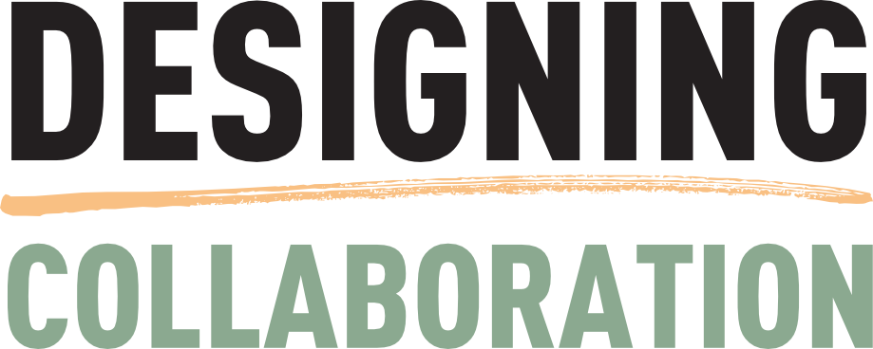
Next level digital team building
Boye & Co
Andrew Pope Owner, Consultant andrew@innosis.eu +44(0)7508 906504
https://www.linkedin.com/in/andrewneilpope/
www.innosis.eu
@TomorrowsPope

Slide 2
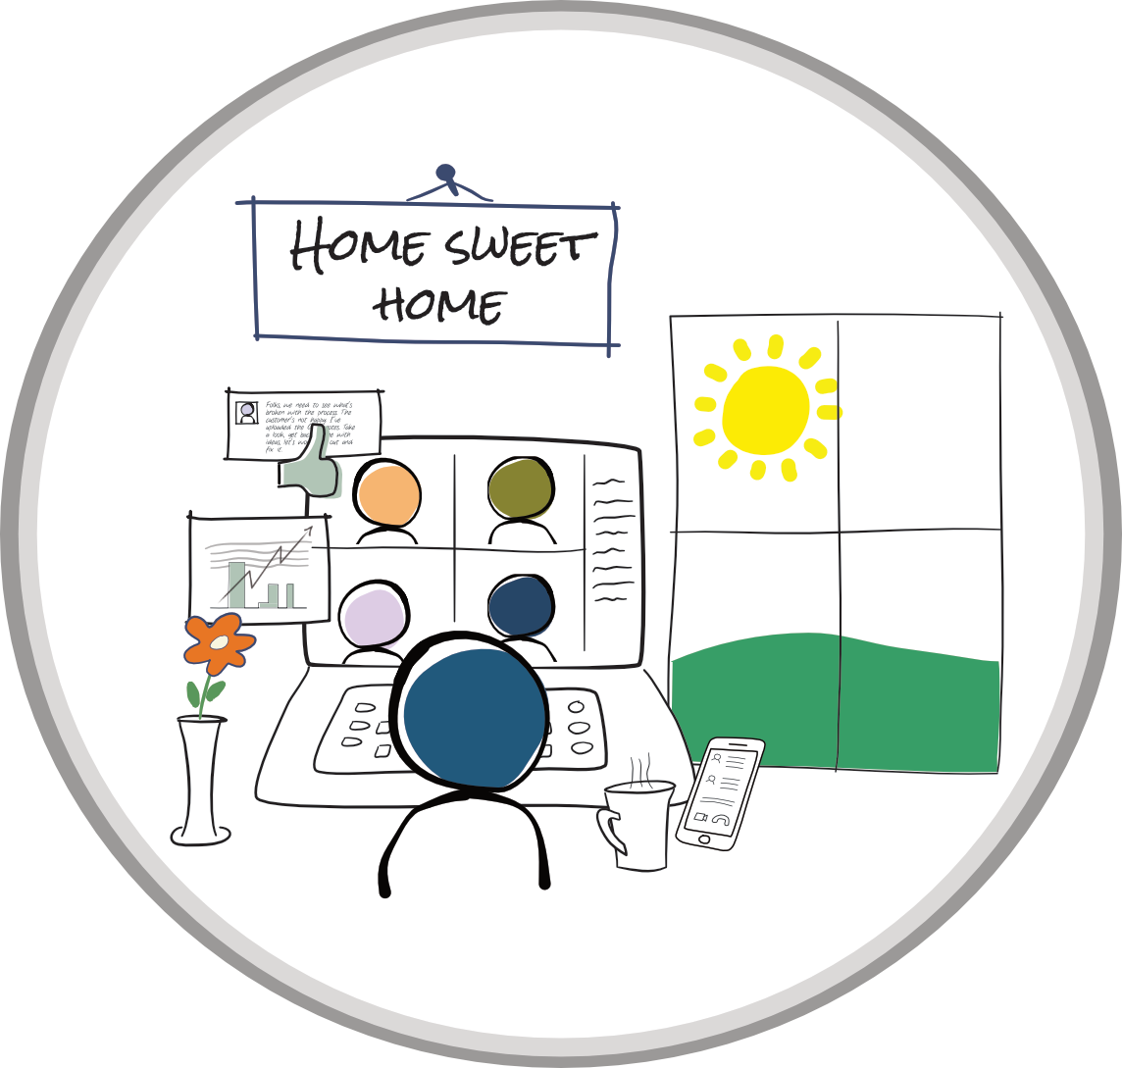
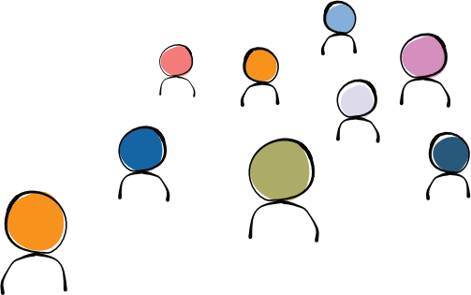
Why is digital teamworking important?
The switch to remote working has mostly been successful
Tools such as Teams have worked – to a degree
With everyone remote, teamworking is balanced. We all have the same experience (except for the swine with the garden office)
But:
Many organisations haven’t mastered digital team skills
The 9-5 has become the 7-6, the 8-7 etc
We are still swamped with meetings
We are still working synchronously
What happens when some of us return to the office?
How do we maintain balance then if we don’t change our habits now?
Our new tools will increase productivity!

Slide 3
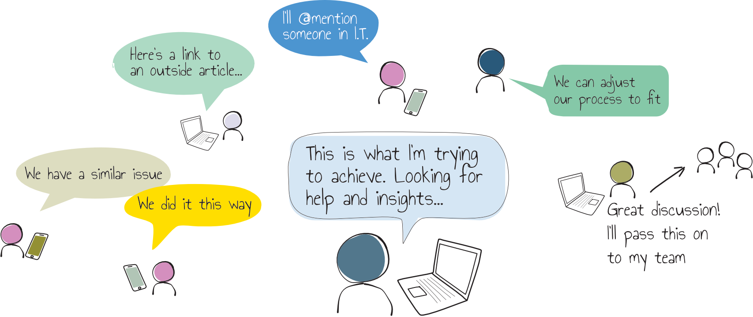
Digital Teamworking, not features
Mastering channels to power digital teamworking
Getting into asynchronous work habits to give us flexibility and cut back meetings
Behaviours that drive good digital teamworking
Techniques we can all adopt in Teams that help the team
Basic governance to start using Teams well
Finding your ‘What’s in it for me’?
Our new tools will increase productivity!

Slide 4
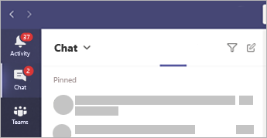
Starting with people, not the tools
Technology
Finding goals and understanding what’s important for digital teamworking
Habits
Culture
Find new strategies, behaviours and techniques to apply
Process
Understand what’s going to stop us
Actions and techniques in Microsoft Teams and Yammer

Slide 5
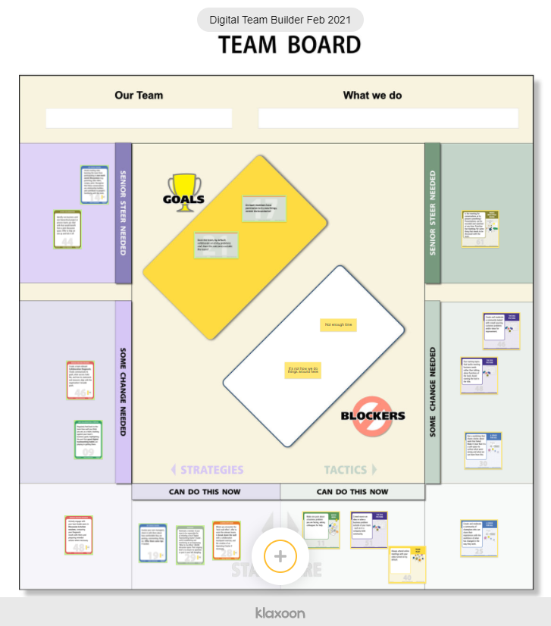
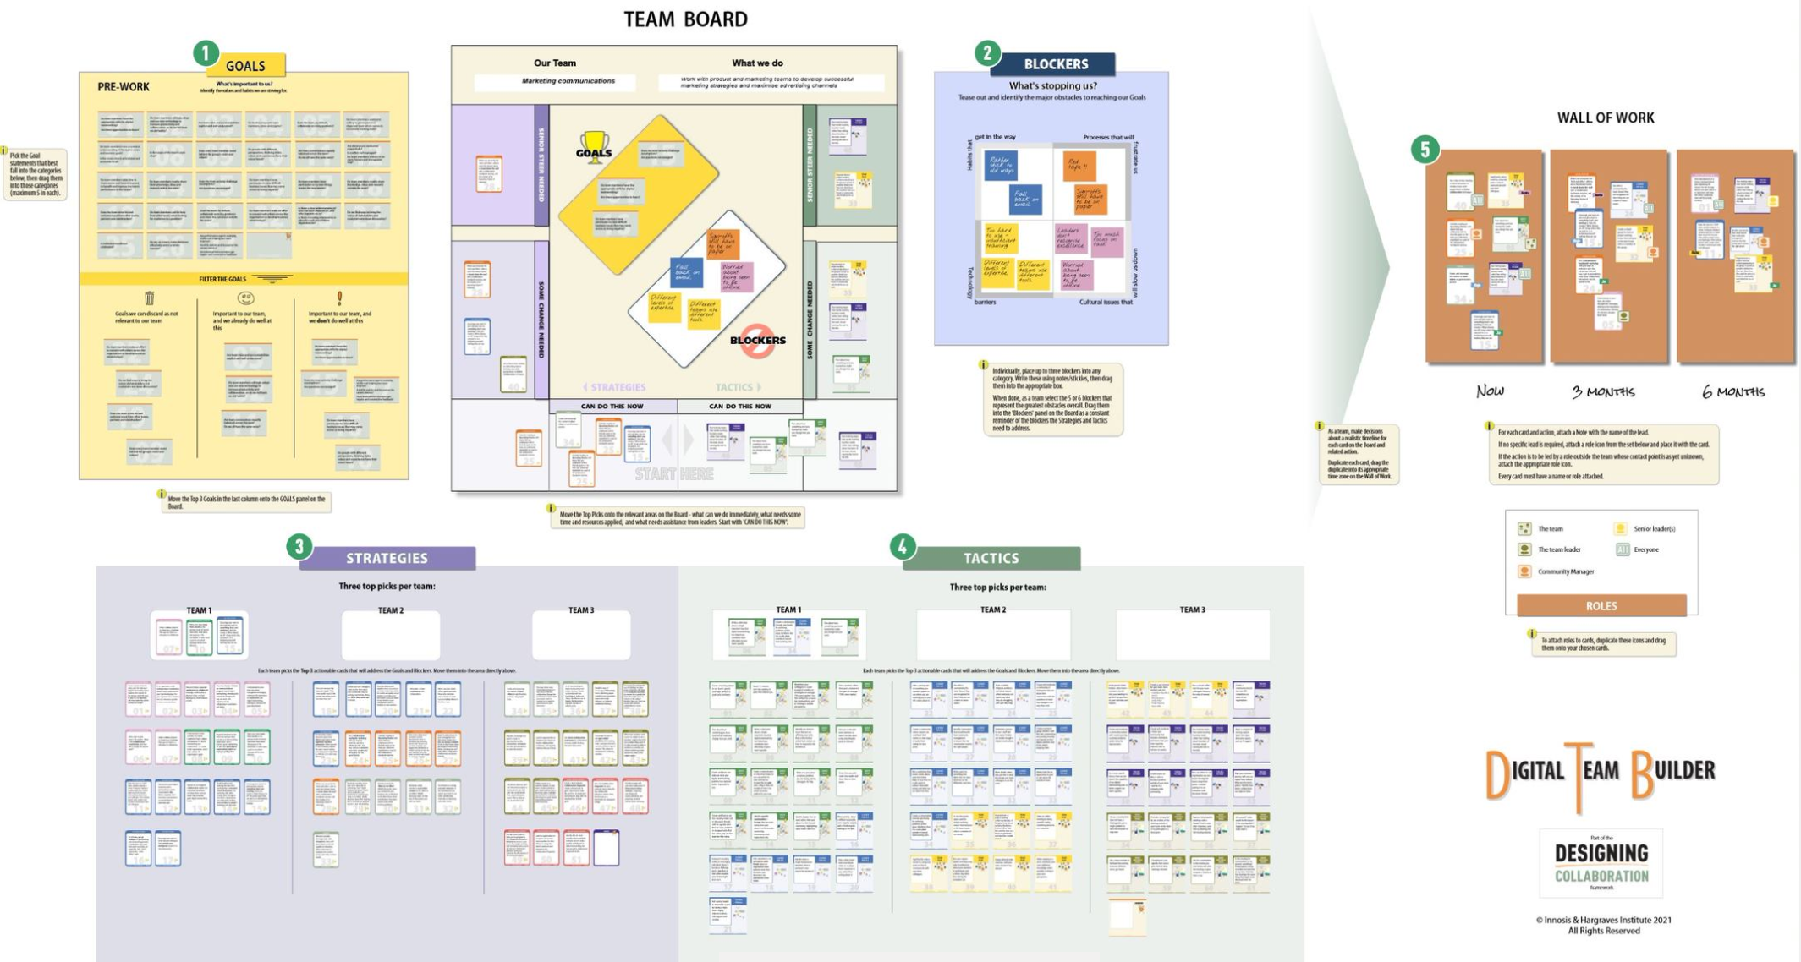
Digital skills workshops
As used for UK Government clients
Our new tools will increase productivity!

