Slide 1
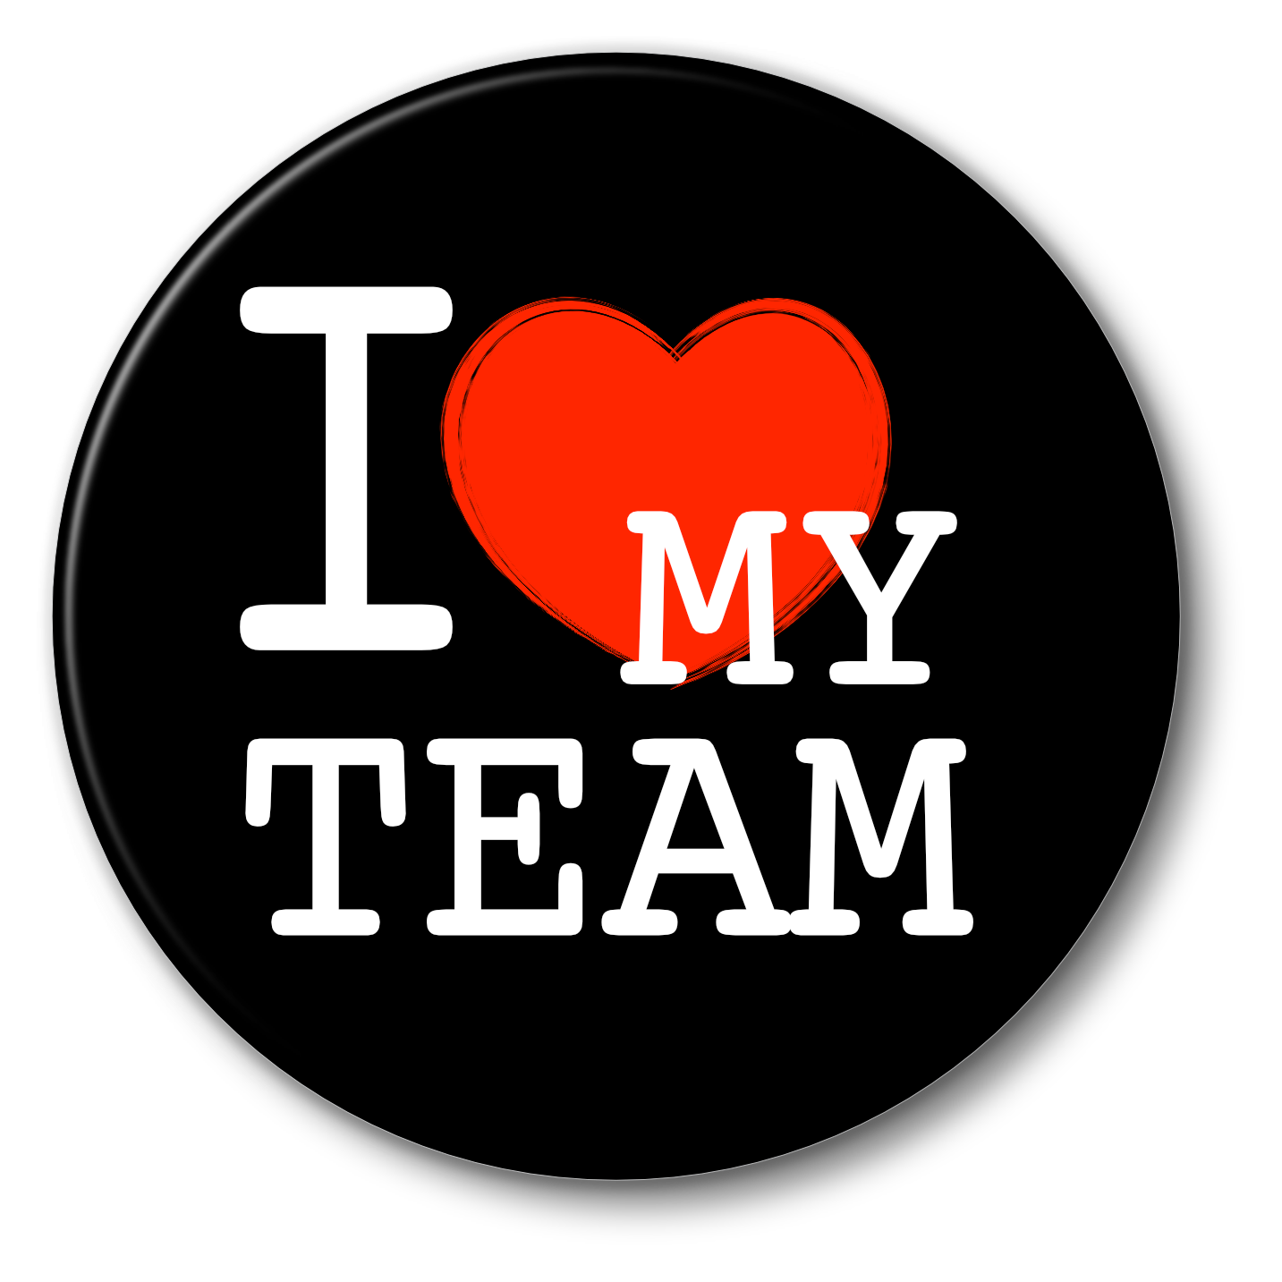
Playing games to find focus
Andrew Pope Owner, Consultant andrew@designingcollab.com +44(0)7508 906504
https://www.linkedin.com/in/andrewneilpope/
www.designingcollab.com
@TomorrowsPope

Slide 2
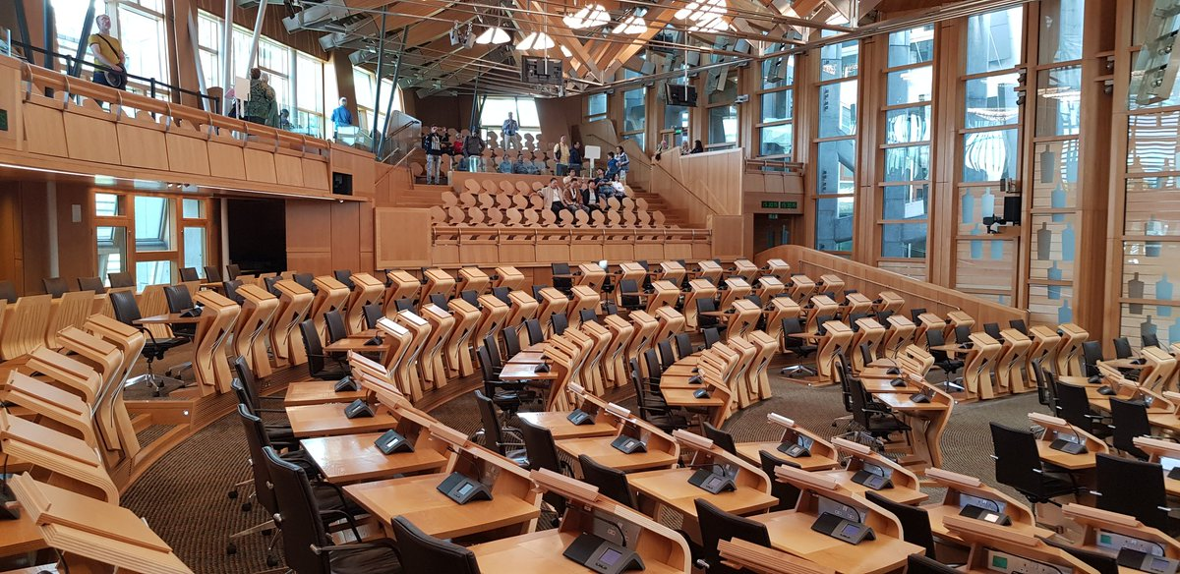
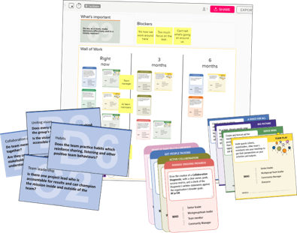
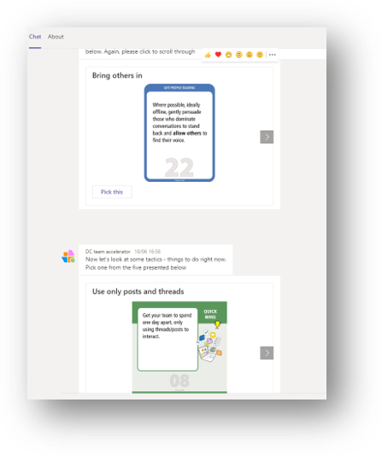
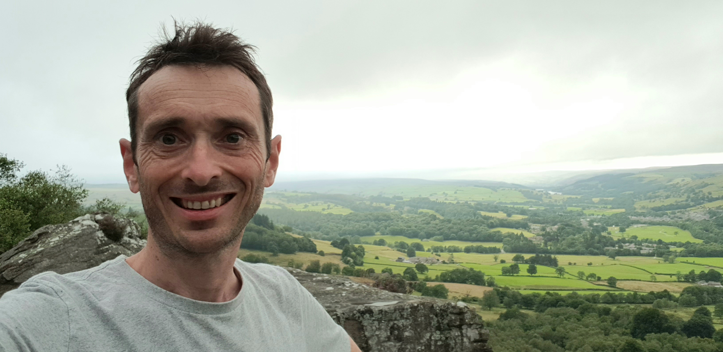
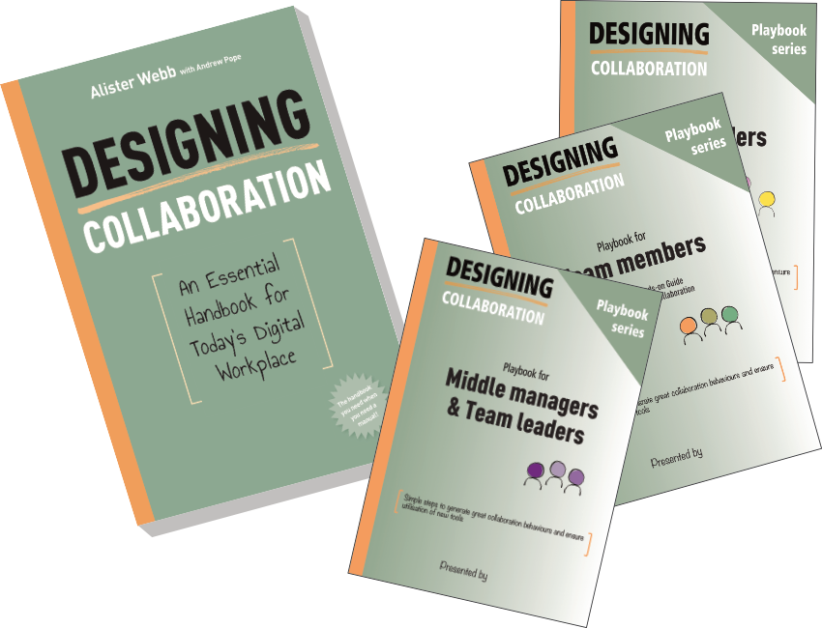
Digital team skills & hybrid working workshops and training for the Scottish Parliament, Rolls Royce & UK Government Agency
Digital transformation advisor and change community leader for Microsoft 365 at global sciences firm (23,000 employees)
Co-author of Designing Collaboration. Built a Teams chatbot
Often spotted here, North Yorks

Slide 3
Digital Team Builder Problems and solutions
Collectively find what is important, and what we need to do better
Surface what will get in the way. What known issues will impede us?
Team, department or organisation
Deal out the cards- strategies and everyday practices. What do we want to try?

Slide 4
Digital Team Builder
Over 150 workshop cards
Quick play 50 cards TeamPlays pack
Developed for digital skills and team-building workshops
Used with UK Government clients to develop hybrid working strategies on Teams
Based on good collaboration best practice, focused on digital working. Strategies all derived from the Designing Collaboration book. Practice cards from practical experience
Our new tools will increase productivity!
Goal cards

Slide 5
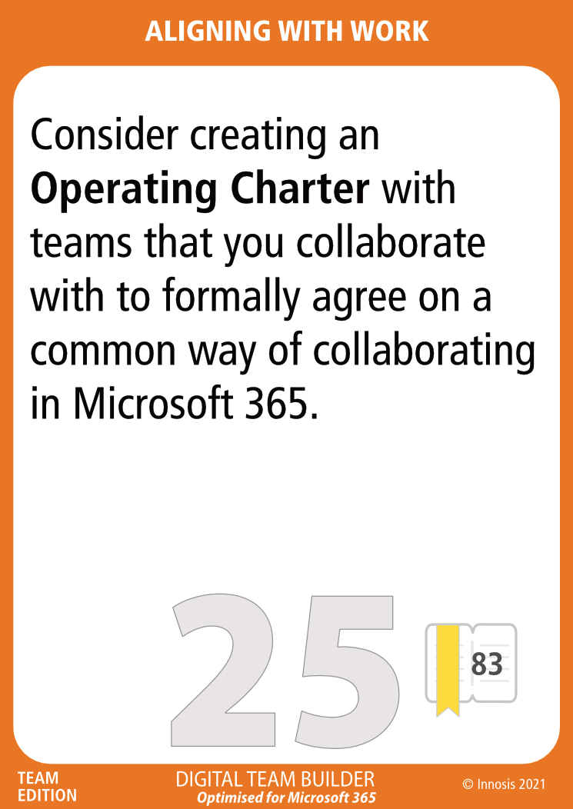
Digital Team Builder Strategies and Everyday Practices
Strategy cards
Our new tools will increase productivity!
Everyday Practice cards

Slide 6
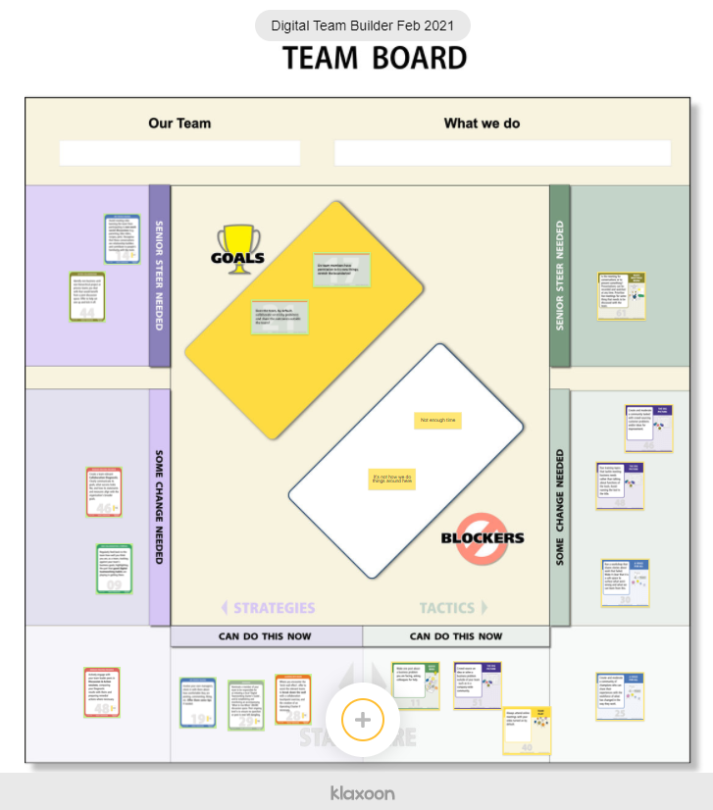
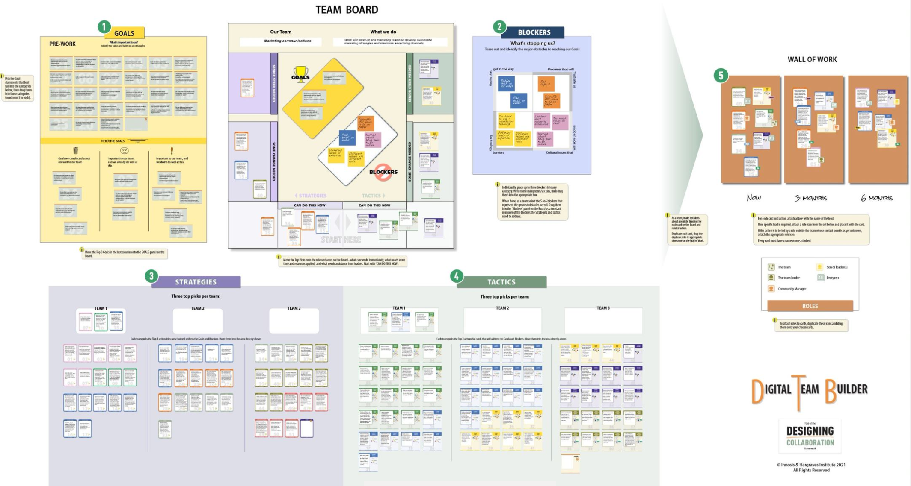
Case STUDY – Hybrid strategy, UK Government Agency
Our new tools will increase productivity!

Slide 7
What will help you find ways to focus in your digital work?
Our new tools will increase productivity!
Notes:
Share details about how you like to work
Keep digital teams small, ideally less than ten per team
Hold conversations in focused channels, not via email
Replace status update meetings with a threaded conversation
Adopt a token to say our team is a safe place to collaborate
Create an operating charter for teams you collaborate with

Slide 8
Every team is unique
We have unique needs as well as many shared issues
There are so many simple things we can all try without too much effort
What will you do differently tomorrow?
Thank you!
Andrew Pope Owner, Consultant andrew@designingcollab.com +44(0)7508 906504
https://www.linkedin.com/in/andrewneilpope/
www.designingcollab.com
@TomorrowsPope

