Slide 1
Uponor – Happy Editors and Great Websites
May 23, 2023
Delfin Vassallo, Jan Havel

Slide 2
Uponor – A global leader in moving water through cities and buildings
€1.4 billion net sales (2022)
80 countries where Uponor products are sold
4,000 employees
Notes:
Goal: To open a digital channel for sales and customer portal for self-service. Save time of professionals (customers). Improve internal efficiency (APOK). 380 employees, 45 location.
Specifics of B2B ecommerce in construction.
Goals 2023: 1) Building brand awareness 2) Increase in B2B customer leads 3) MyAPOK goals: +30% MyAPOK registrations +15% revenue from registered users increase online training subscriptions

Slide 3
30+ languages, 5000+ pages
Notes:
Decentralized editors
Country-specific customizations and components
Very expensive to maintain and unhappy editors – no way to persuade them on leveraging advanced features

Slide 4
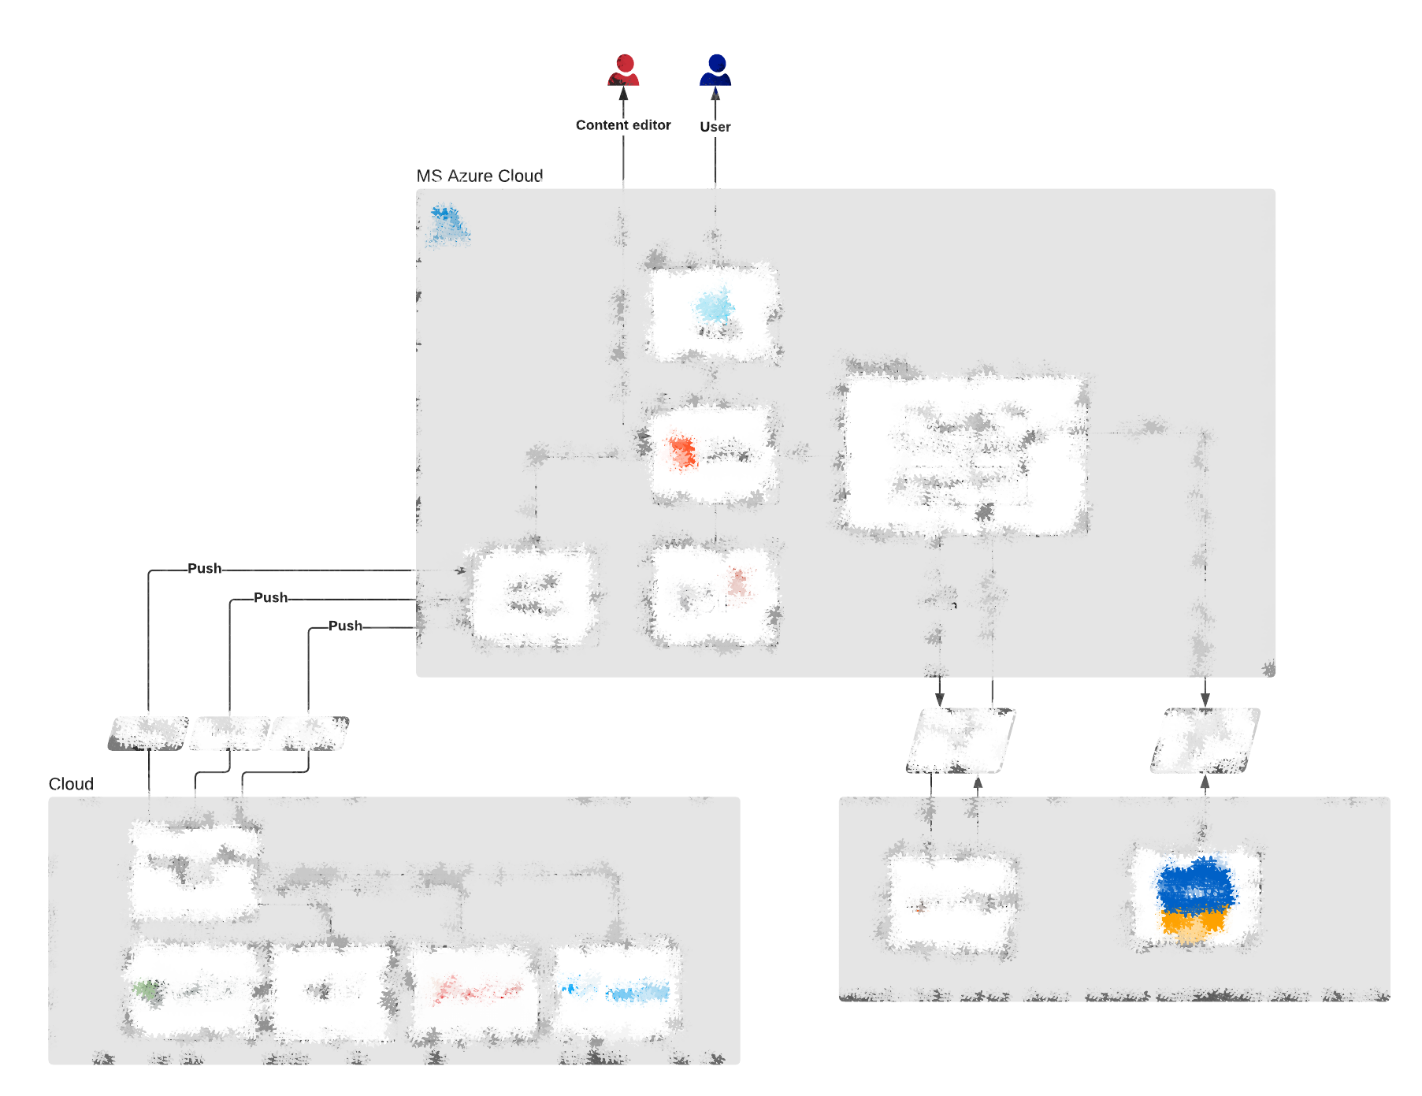
Solution supporting all stages of content life cycle…
across 30+ websites in 20+ languages
integrating several data sources 4 000 employees
Notes:
How many systems will editors have to use to complete a task?

Slide 5
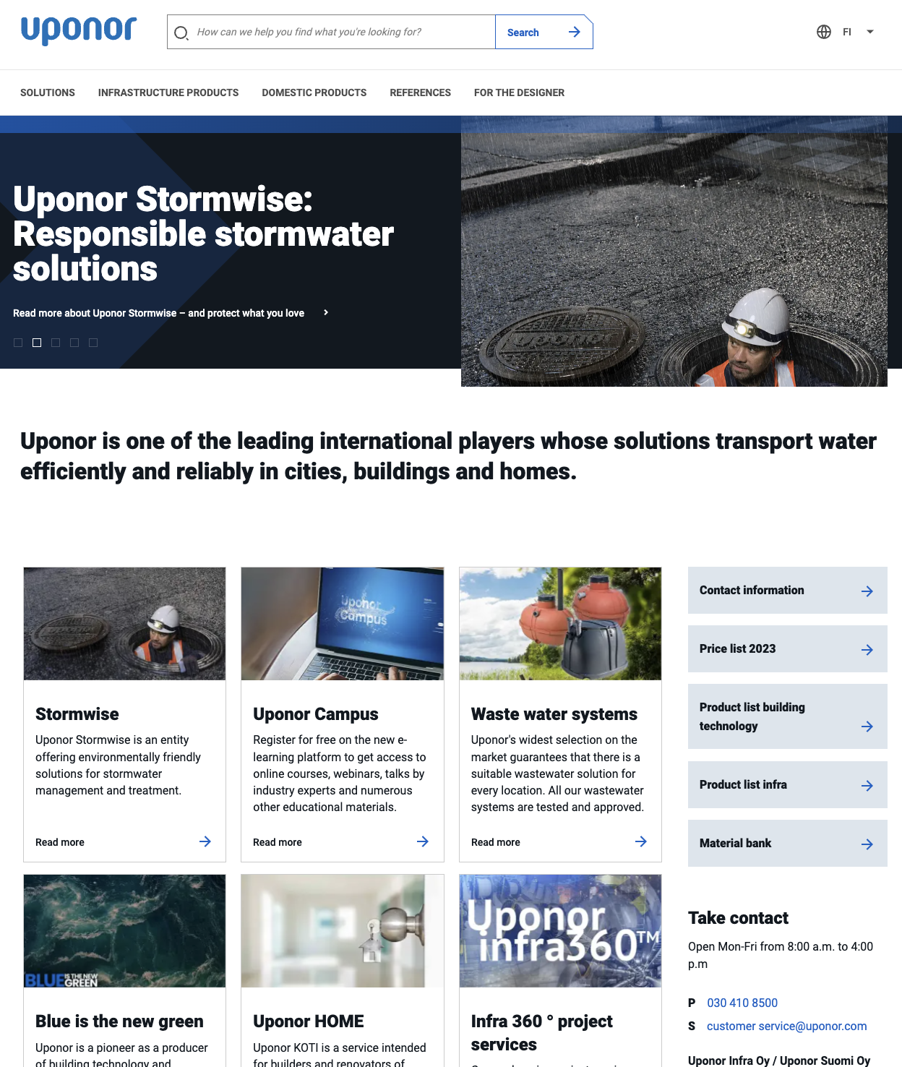
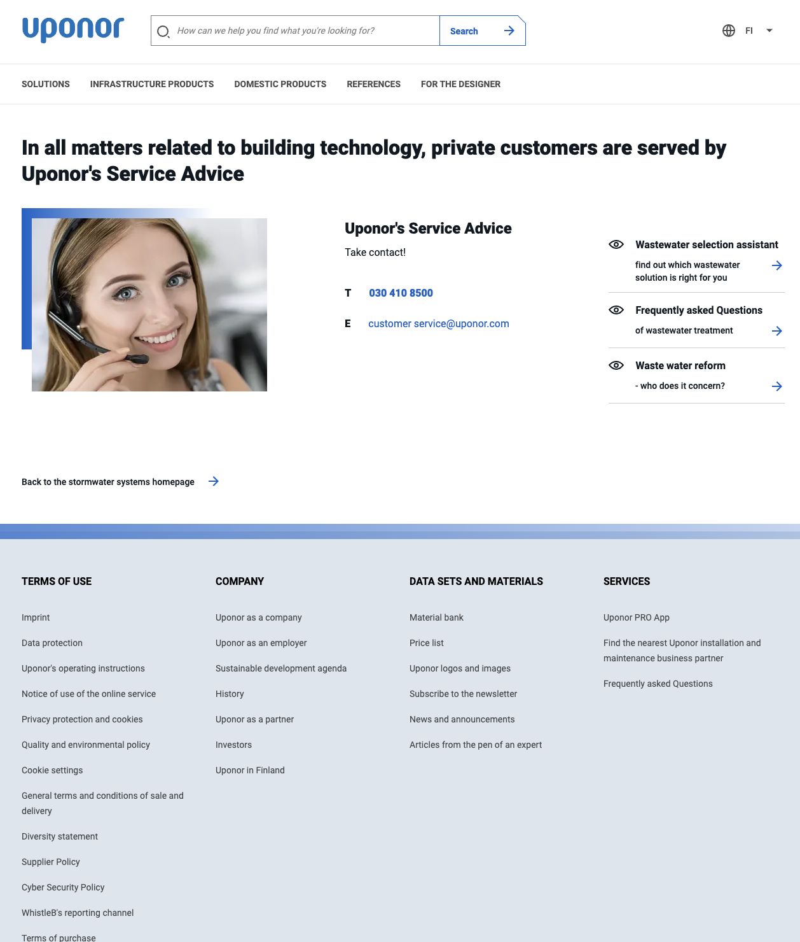
Unification of component library
40+ re-usable components (30 implemented in Uponor web)…
Notes:
Reality: 650 MDs total effort including custom dev ecommerce

Slide 6
Fit to standard
Notes:
F2S approach known from SAP (modify company, don’t touch systems)
Reference architectures in solution architecture
Component libraries in CMS
Needs buy-in of editors – “We have always done it this way” “We are special”

Slide 7
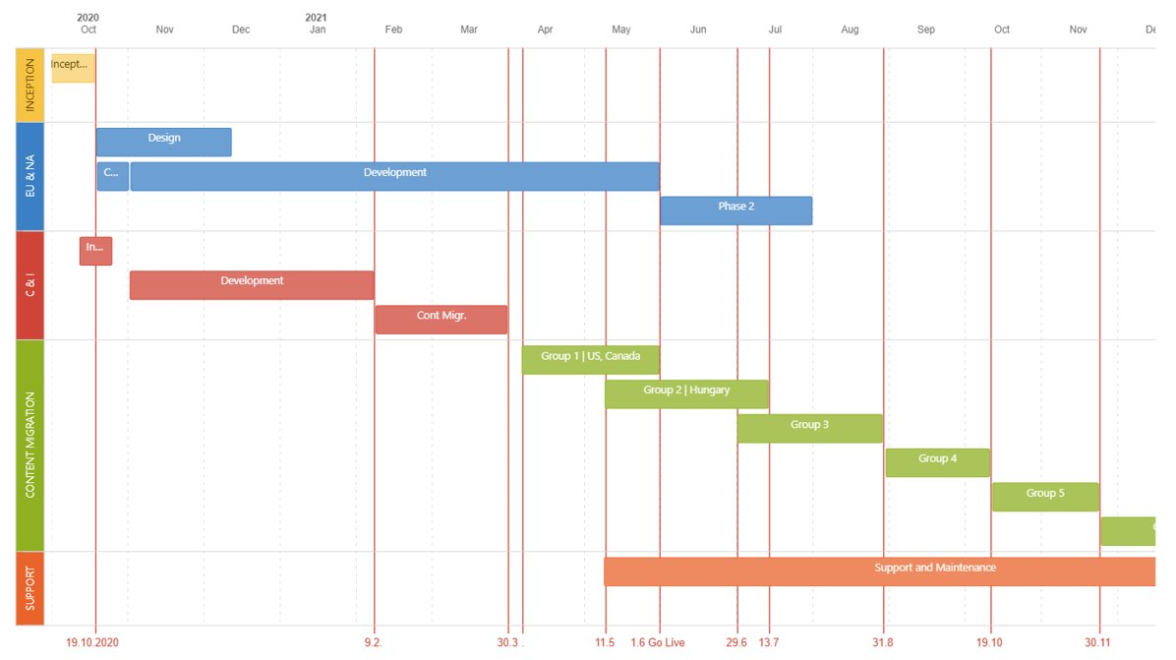
Outsourced content migration
Notes:
6000 hours of work! Editors would hate it – to do it and to learn the system at the same time.

Slide 8
Today? Tomorrow…

Slide 9
Happy editors make better content
--Janus Boye, 2019
Notes:
Delfin about content editors – reduced workload, employee satisfaction, engagement
What it brings and what it enables / unlocks
Time to market / time to value. Improvements – simple for editors, editors engaged?
Future?

