Slide 1
Creating the perfect user experience both online and offline
…yes, we also believe in unicorns
Flemming R. Kristensen, CMO, Krifa

Slide 2
Agenda
Introducing marketing automation in an organization
From ‘triggered by us’ to ‘triggered by you’
Offline vs. online – why MA makes sense
Challenges – why change?
Our dream 2.0

Slide 3
Introducing marketing automation in an organisation
Yes, it is every CMOs dream scenario –
no, it does not happen overnight.
Notes:
And no, God no, is it done by buying a marketing automation system, making it a strategic focus and creating a team around it.
But it sure helps.
Question?
How many have tried this?
How many are on the verge of introducing marketing automation?

Slide 4
Our dream
We want relevant, automated communication by customer behavior.
So, where to begin?

Slide 5
What did we do?
We bought Agillic – a fancy marketing automation system
…can you feel the success knocking on your door a week later?
Notes:
We already worked with email-marketing but wanted more personalized communication.
We bought a fancy system, Agilic, which can do almost anything short of making coffee.
Allocated people to work with marketing automation – data integrations, e-commerce, content, graphic
Made it a toppriority within the organization to ensure that time and resource were spent on implementing marketing automation. This type of focus made I possible for several people to dedicate time to work with marketing automation.
It is not something which happens over night – or is done by buying a system. It takes continuous focus across many different people and skills to make it a success.

Slide 6
What really happened…
New systems –> new processes.
…and success as well as errors.
And suddenly you have sent 1.8 mio mails
in two months…
Notes:
Error: Like sending 300.000 email while being at lunch (the expected targetgroup was a few 100 that they) – but that’s what happens when you decide to mess around with an automated flow, which happens to look into the targetgroup in that very moments when the only condition to recieve this email is that you have an email adresse and has been in our system at some point.
Bare for at skitsere en af de udfordringer, der kan være ved pludselig at arbejde med automation
We began getting feedback from the organisation… we had changed the tone of voice and the frequency of the emails…said in another way, we didn’t do as we used to.

Slide 7
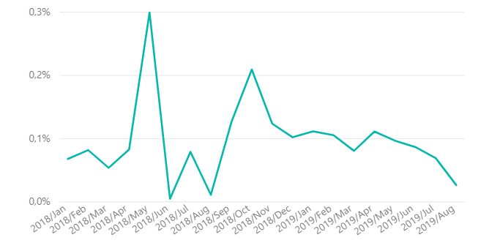
Data always wins…
We were sending too many e-mails… perhaps?
When is it to many?
Notes:
Interesting discussion – if the mails are irrelevant, 3 mails a week are to many, if they are irrelevant. But if the content is relevant you
you won’t mind recieving 5 mails a week.
The challenge really appears when you mix blast (triggered by us) with automated mail (triggered by them) as we cannot control when people activate which flows.
We have chosen to look at unsubscribtion rates as a data-drive way of looking at when we were sending to many mails.
The two peaks are:
GDPR – everybody in our database recieved information about GDPR
We were on a roll, and the organisation had suddenly rediscovered email as a channel …so we were sending blastmails and flows in one huge mess
After what soon became known as email-gate we started working with a ‘max one mail pr. day pr. recipient’ rule.

Slide 8
…and the customer is always right
They expect relevant and personalized communication – and they will tell us when we fail!
Notes:
An unemployed member unfortunately received an e-mail describing how great coworkers are and how much they mean for you general well-being at worked. She was so offended, that she actually wrote back to us complaining about that e-mail ‘as she did not have any colleagues and we ought to know that!’ Which, by the way, it a fair point to make.
But most of the time – as our data indicated we succeeded in creation personalized and relevant communication….to the right target groups ;)

Slide 9
…the sceptics inside…
Have you ever heard this, when introducing marketing automation?
Do we really need to send MORE e-mails?
What’s wrong with the way we used to do it?
Notes:
Yes, if it is relevant – irrelevant communication is annoying whether it is 1 or 10 mails a week
Timing – inside out information – what we wanted to tell instead of what they wanted to hear

Slide 10
Question
What have you done to make marketing automation the new normal inside your organization?
Do’s and don’ts..

Slide 11
‘I think…’ and therefore you are…but data wins
Before: All e-mails were triggered by us
After: E-mails can be triggered by the recipient
Notes:
Data can make communication more relevant…
The is a time before marketing automation and a time after
What is the difference?
Before Agillic
All emails were triggered by us – we pushed the button. Total control
After Agillic
An email is triggered by the recipient
Behavior
Engagement score
Static data
So depending on all kinds of things a member could receive one type of mail on any given day, ‘asking’ them to do something, while another member could receive a slightly different mail any other given day asking them to do the same thing (her tænker jeg på GAIS invite og STO bla.)

Slide 12
From BMA to AMA…
I wish a could present rainbows, glitter and champagne…
Notes:
We don’t have the perfect example … but we are close. This example sums up the journey from handheld, offline, non-trackable campaign to a completely digital and 100% trackable campaign.

Slide 13
Imagine this in a not so distant past…
2018
Letters were written, packed and sent by snail mail.
The same people who got the letter received a phone call.
Notes:
Close to cold-calling (ved ikke om jeg har fat i det helt rigtige udtryk her)
The criteria to receive this letter were vast and static – and the list created in excel each time this campaign went out. The budget for stamps alone… Not to mention that the timing was random at best.

Slide 14
Closer to the dream…
Spring 2019
The physical letter was replaced by an e-mail. Oh joy!
Some people, but not all, still got a phone call.
Notes:
Spring 2019
The physical letter was replaced by an email. Oh joy!
Numerous advantages – not to mention not paying for stamp – but we could see who read and interacted with these mails.
Some people, but not all, still got a phone call. (everybody who opened the mail)
A bit warmer than cold-calling

Slide 15
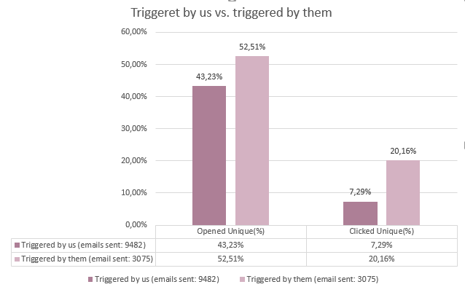
And the crowd goes…
Autumn 2019
100% automation – and omnichannel. Yay!
Notes:
The criteria to enter this flow are now a combination of static data and online behavior.
We nudge you on FB and our website, if you comply you might get a mailflow, if you engage with us in our mails and on our website, you might just get a phonecall. But only those who seems to be interested right now – yes, content might be king, but timing is everything.
So far open rates and clickrates are way better than in the spring – again, timing is crucial.
Concern (especially for the impatient) – volume… it takes time to build a significant volume, but the expectation is that it pays off in the end.

Slide 16
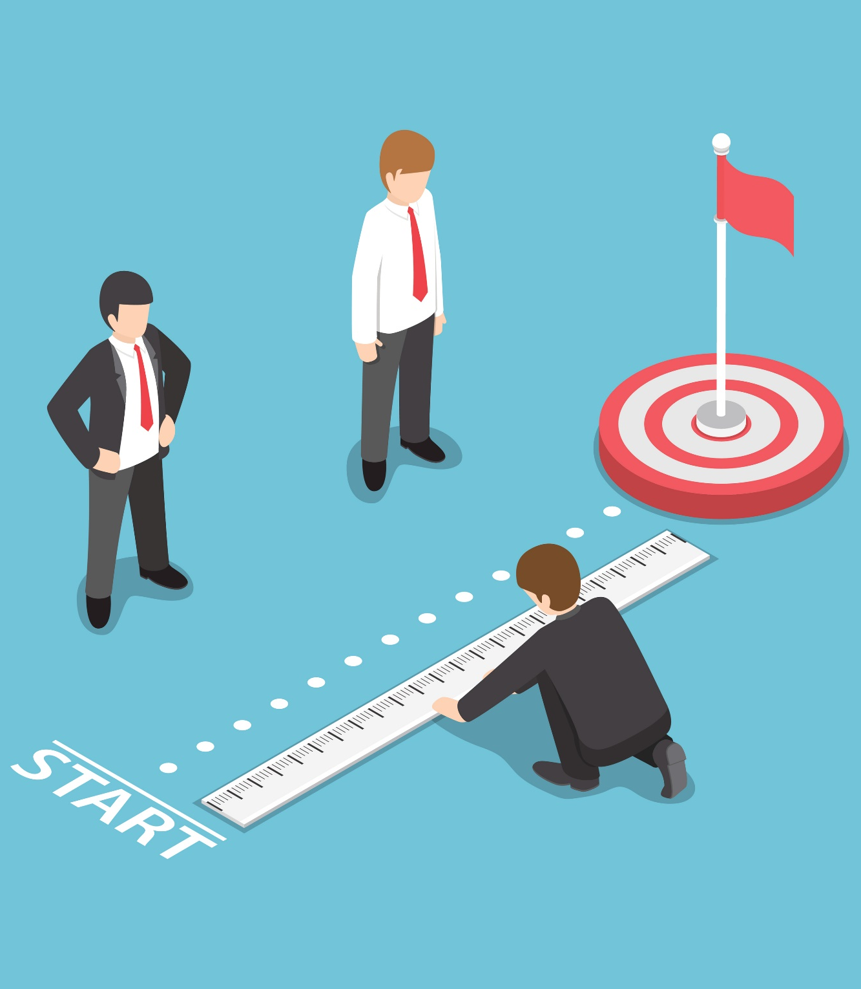
Are we there yet…
…said the impatient CMO … I mean… teenager on the backseat
Do we ever get there?
Our dream 2.0
Notes:
Do we ever get there?
Probably not – new technology keeps surfacing
The organizations: continuous evaluation and adjusting vs. new marketing automation projects. Depending on the profiles, one side will always suffer…
Our dream 2.0
Optimize our existing flows with omnichannel and leadscoring
Smarter blast-mails – segmentation based on static data and previous email-behavior fx., and sent time optimization
What about those who haven’t got a digital behavior?
- integrating offline behavior – when they visit us in their local department, when we speak on the phone – how do we make this information available and usable?
Right now the dream is omnichannel and automation based on behavior – both offline & online (not either or)

Slide 17
Questions?

