Slide 1
Initiatives for reducing CO²
Digitale Kanaler og kommunikation
On the digital systems of The Danish Ministry of Taxation.
Janus Djurhuus Rose
Digital Art Director
Digitale Kanaler og Design DKD
The IT and Development Agency
of the Danish Ministry of Taxation
(Udviklings- og Forenklingsstyrelsen)

Slide 2
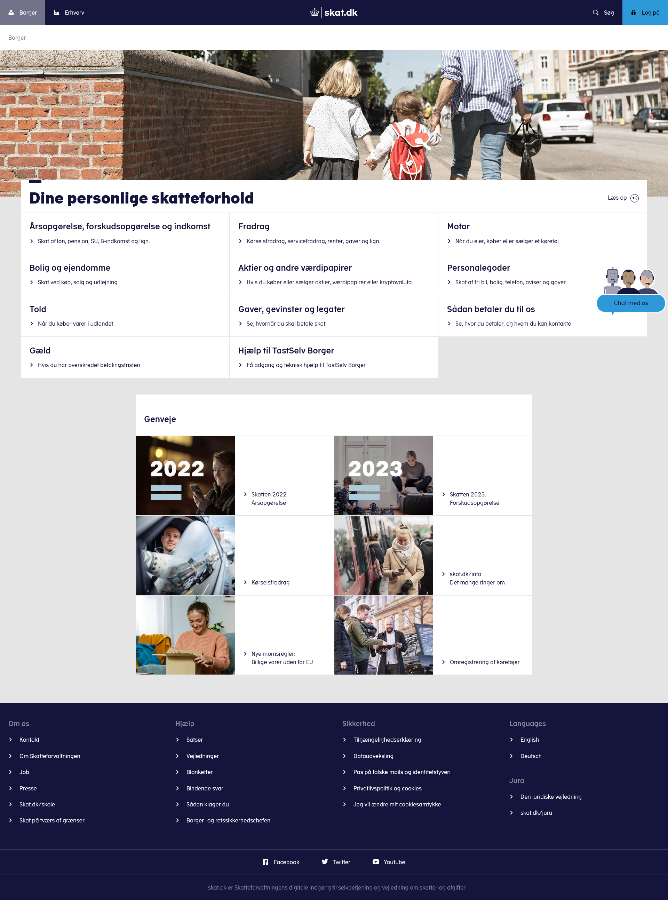
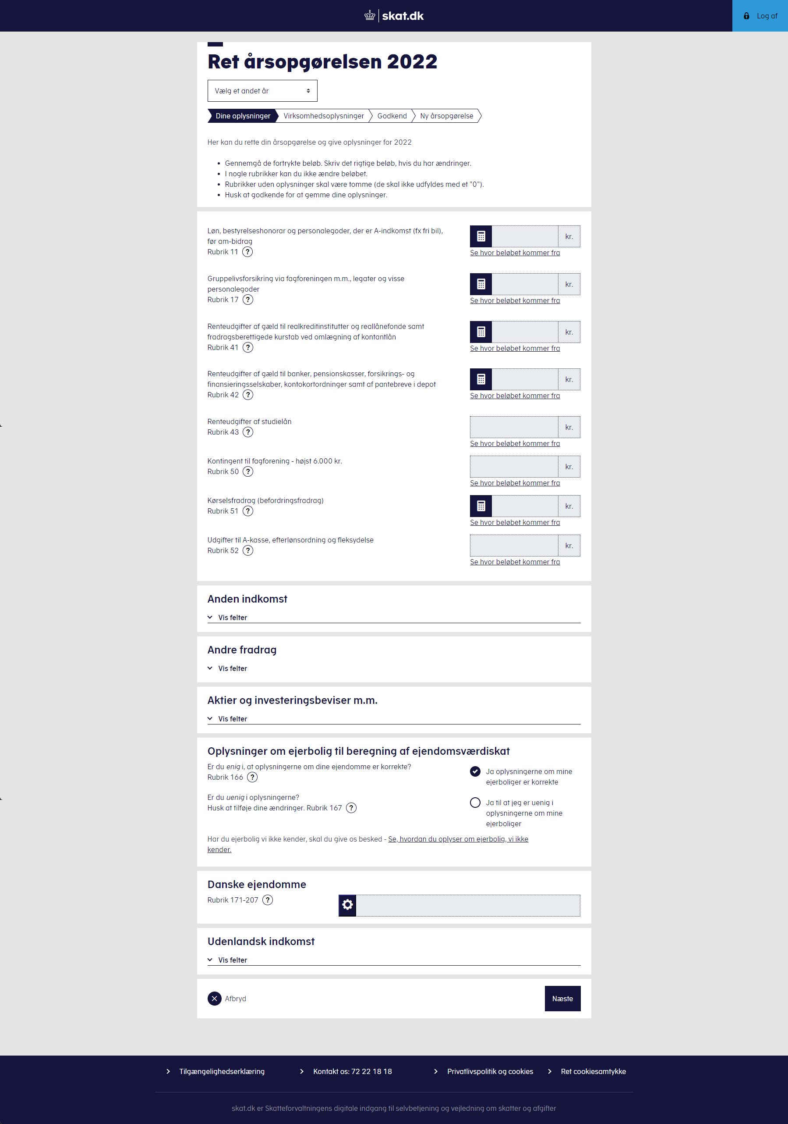

Slide 3
The Design System is component and standards library that all Digital products within the Ministry of Taxation shall adhere to when developing UI.

Slide 4
Law
CVI
Good ideas
UI and markup
Components and standards
In the Design System
Tech
Standards

Slide 5
That’s all very interesting,
but what does this has to do with sustainability?
Well, it all started with CO²-check on skat.dk

Slide 6
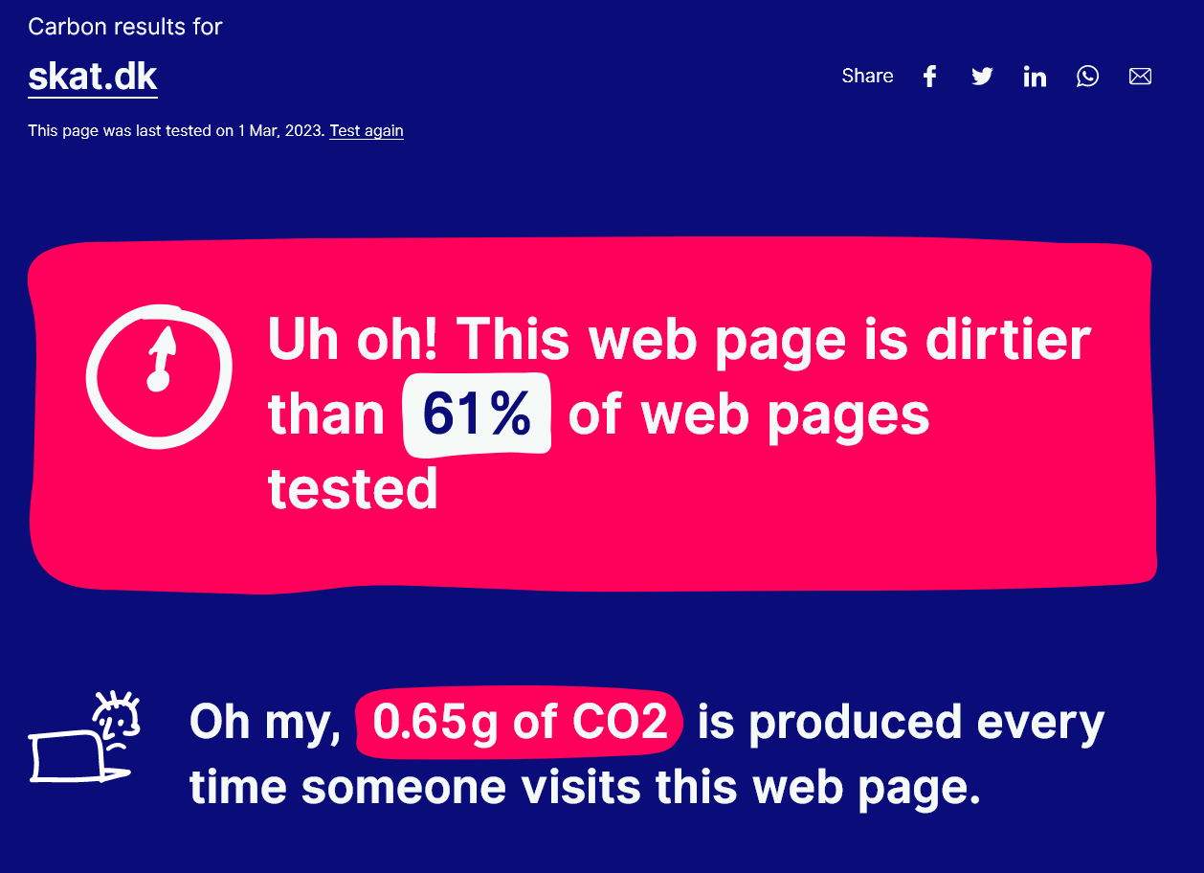
Det startede med en CO²-måling på skat.dk
WebsiteCarbon.com

Slide 7
Skat.dk emits
21 tons CO²/yr
That’s about two Danish people’s emissions in a year.
Source:: Klima Energi og Forsyningsministeriet
theguardian.com

Slide 8
We acknowledged that we are a contributor to climate change. We as a standard setting office, felt that it was our responsibility to do something about it
bøvl
substantiv <-et>
hassle - I cannot be bothered with the hassle
trouble - It is too much trouble to cancel it now
bother - I hope that it is not too much bother for you
But changing stuff can be bøvlet

Slide 9
The bøvl matrix
The anti-Bøvl
General support among colleagues, leaders and the Minister
Money is not all. Time is also vital.
The Bøvl
New CMS
Legacy Systems
Rigid contracts with few vendors
Unclear law and standards
Source: Støvledans

Slide 10
BUT: Taxonomy about green procurement is already defined by the EU GPP The Agency for Digital Government (Digitaliseringsstyrelsen) are developing a standardization for procurements upon this taxonomy.

Slide 11
BUT: Taxonomy about green procurement is already defined by the EU GPP The Agency for Digital Government (Digitaliseringsstyrelsen) are developing a standardization for procurements upon this taxonomy. Imagine the Ø-brand or an ISO-standard when purchasing green IT.
Not actual brand-logo!
(just me fooling around in Illustrator)

Slide 12
And they want to help you
Get your procurements
sanitized by Digitaliseringsstyrelsen
Not actual brand-logo!
(just me fooling around in Illustrator)

Slide 13
And they want to help you
Get your procurements
sanitized by Digitaliseringsstyrelsen
We can create green user driven services for everyone.
You will know excactly what a green IT procurement means
Not actual brand-logo!
(just me fooling around in Illustrator)

Slide 14
Task list for DKD
Sustainable IT Conference @ H15 Meat Packer District this fall.
Our grand CMS-transmission this fall.
Climate checking all 3rd party apps
herning.dk?
WCAG2 (accessibility), UX and user journeys
Continuous participation in the standard workgroup
Finding more talented people

Slide 15
Maturity scale

Slide 16
Write if:
You need help with your green procurements
You want to know more, or contribute to this epic pilot project
You want to attend our conference this fall
You want to talk about this and that
Janus.rose@ufst.dk

